Slide 1
Project Alexandria in Viva Topics: AKBC in practice
Yordan Zaykov, Microsoft Research

Slide 2
Outline
Alexandria & Viva Topics
ML challenges posed by the product requirements
A framework to tackle these ML challenges
The future of Alexandria

Slide 3
The aim of Project Alexandria
Automatically extract useful business knowledge into a single, consistent knowledge base & create knowledge-powered experiences that help people and businesses achieve their full potential.

Slide 4
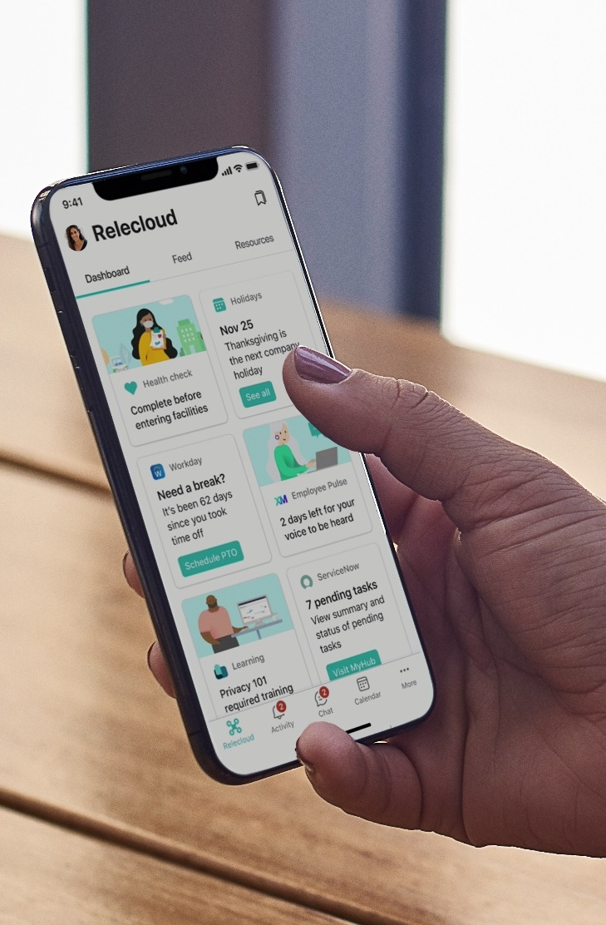
Microsoft Viva: employee experience platform
Viva Connections
Viva Insights
Viva Topics
Viva Learning
Culture and communications
Productivity and wellbeing
Knowledge and expertise
Skilling and growth

Slide 5
Microsoft Viva Topics Knowledge put to work
Viva Topics applies AI to empower people with knowledge and expertise in the apps they use every day by automatically organizing content and expertise across your systems and teams into related topics like projects, products, processes, and customers.
With topic pages and topic centers, experts can share knowledge with wiki-like simplicity.

Slide 6
Viva Topics demo

Slide 7
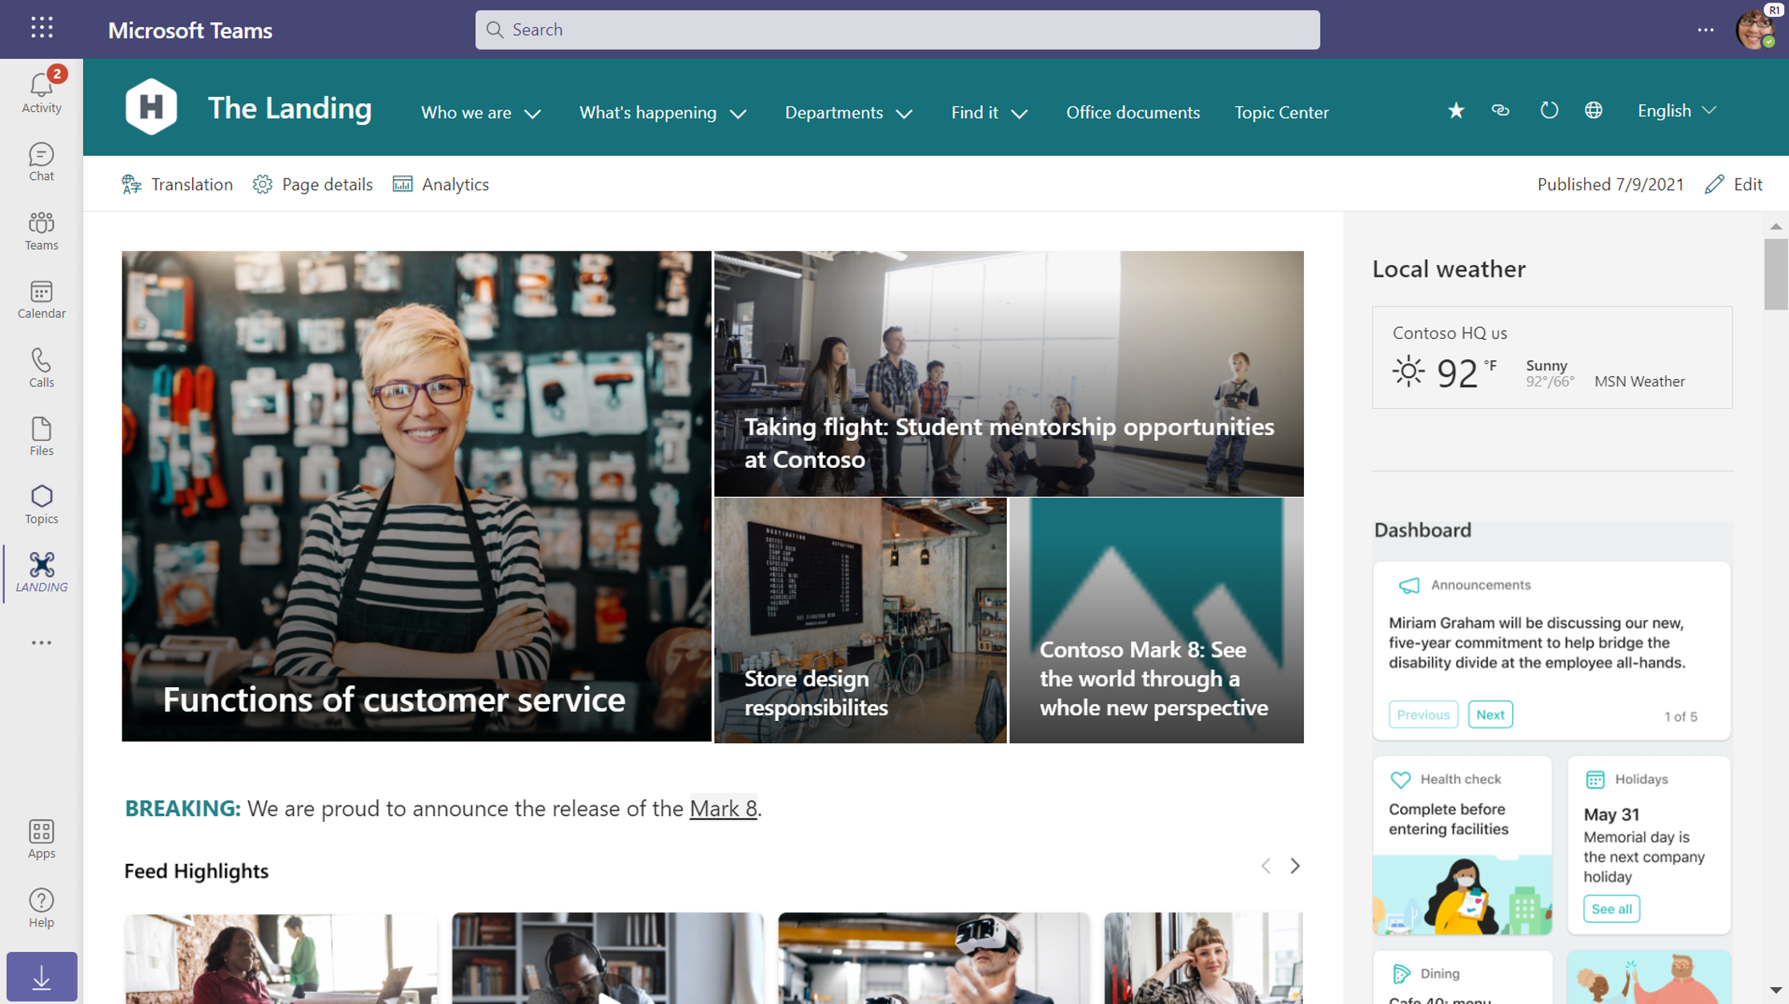

Slide 9
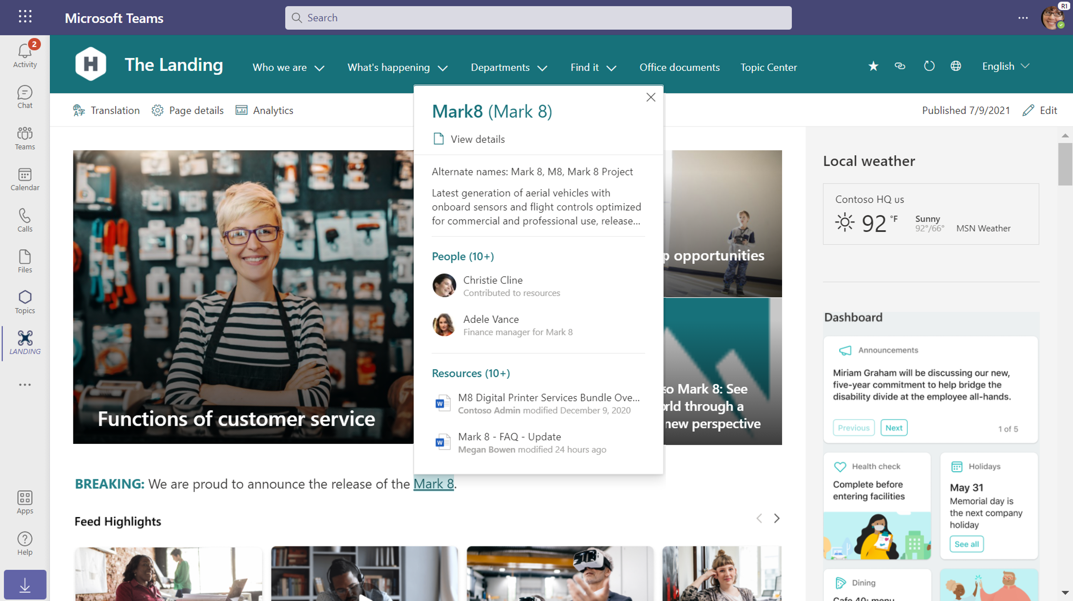

Slide 11
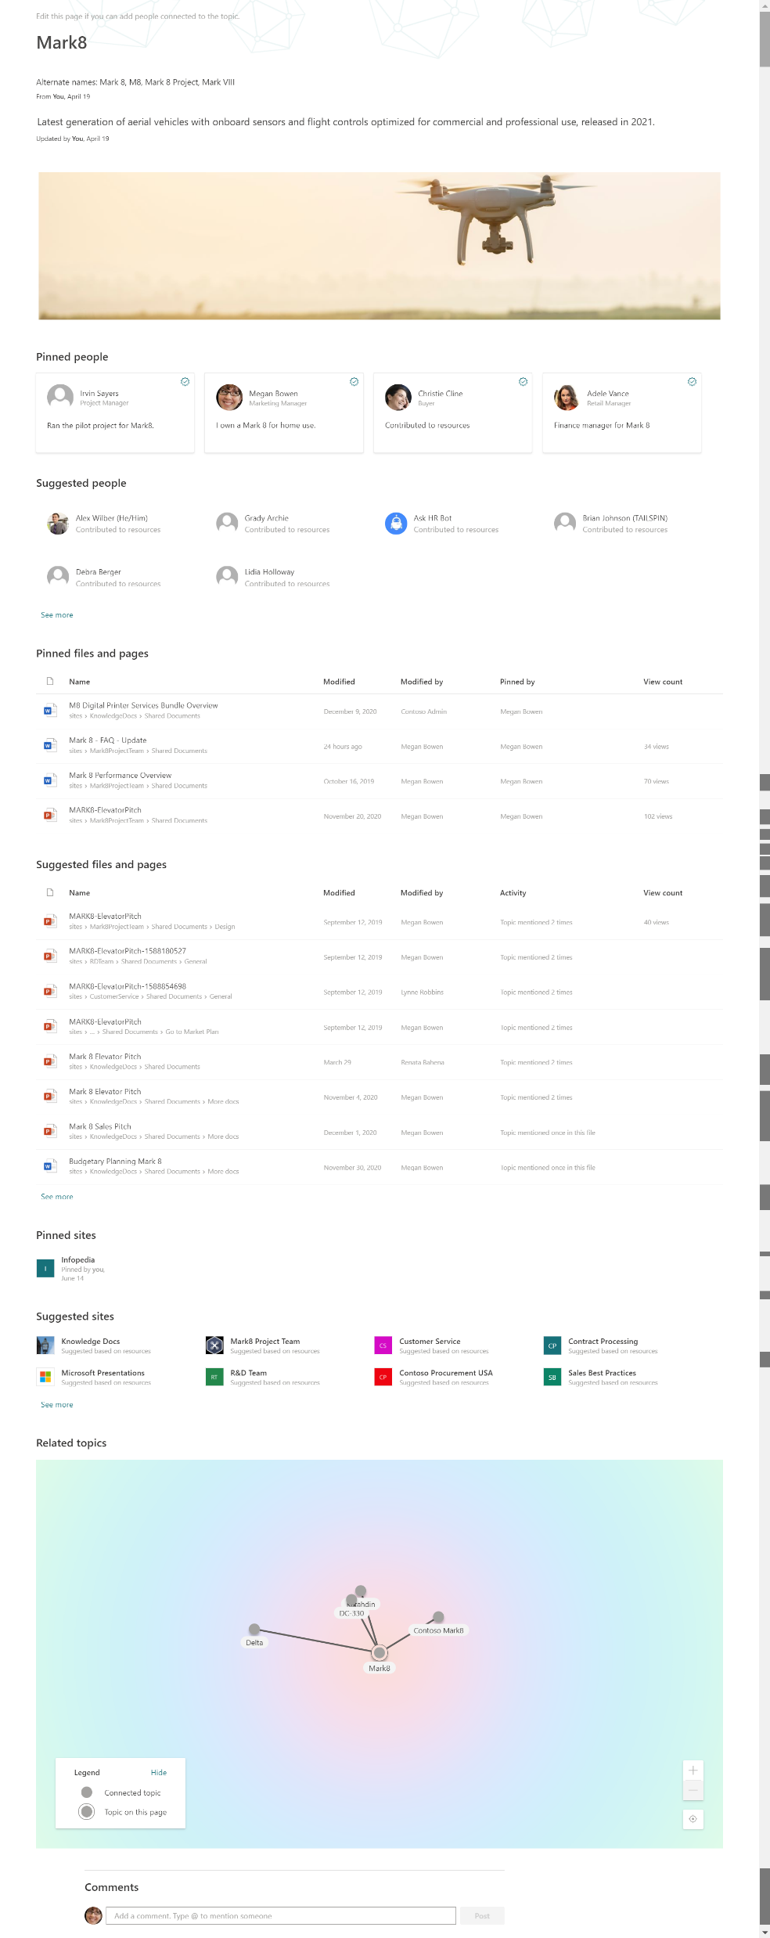

Slide 12
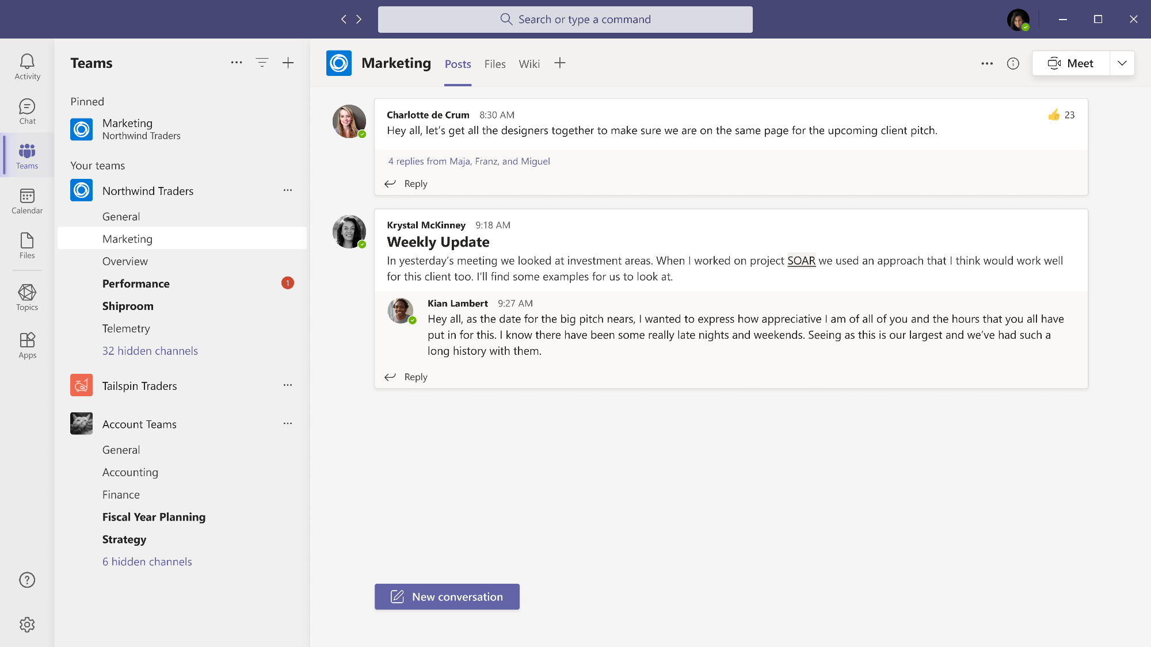
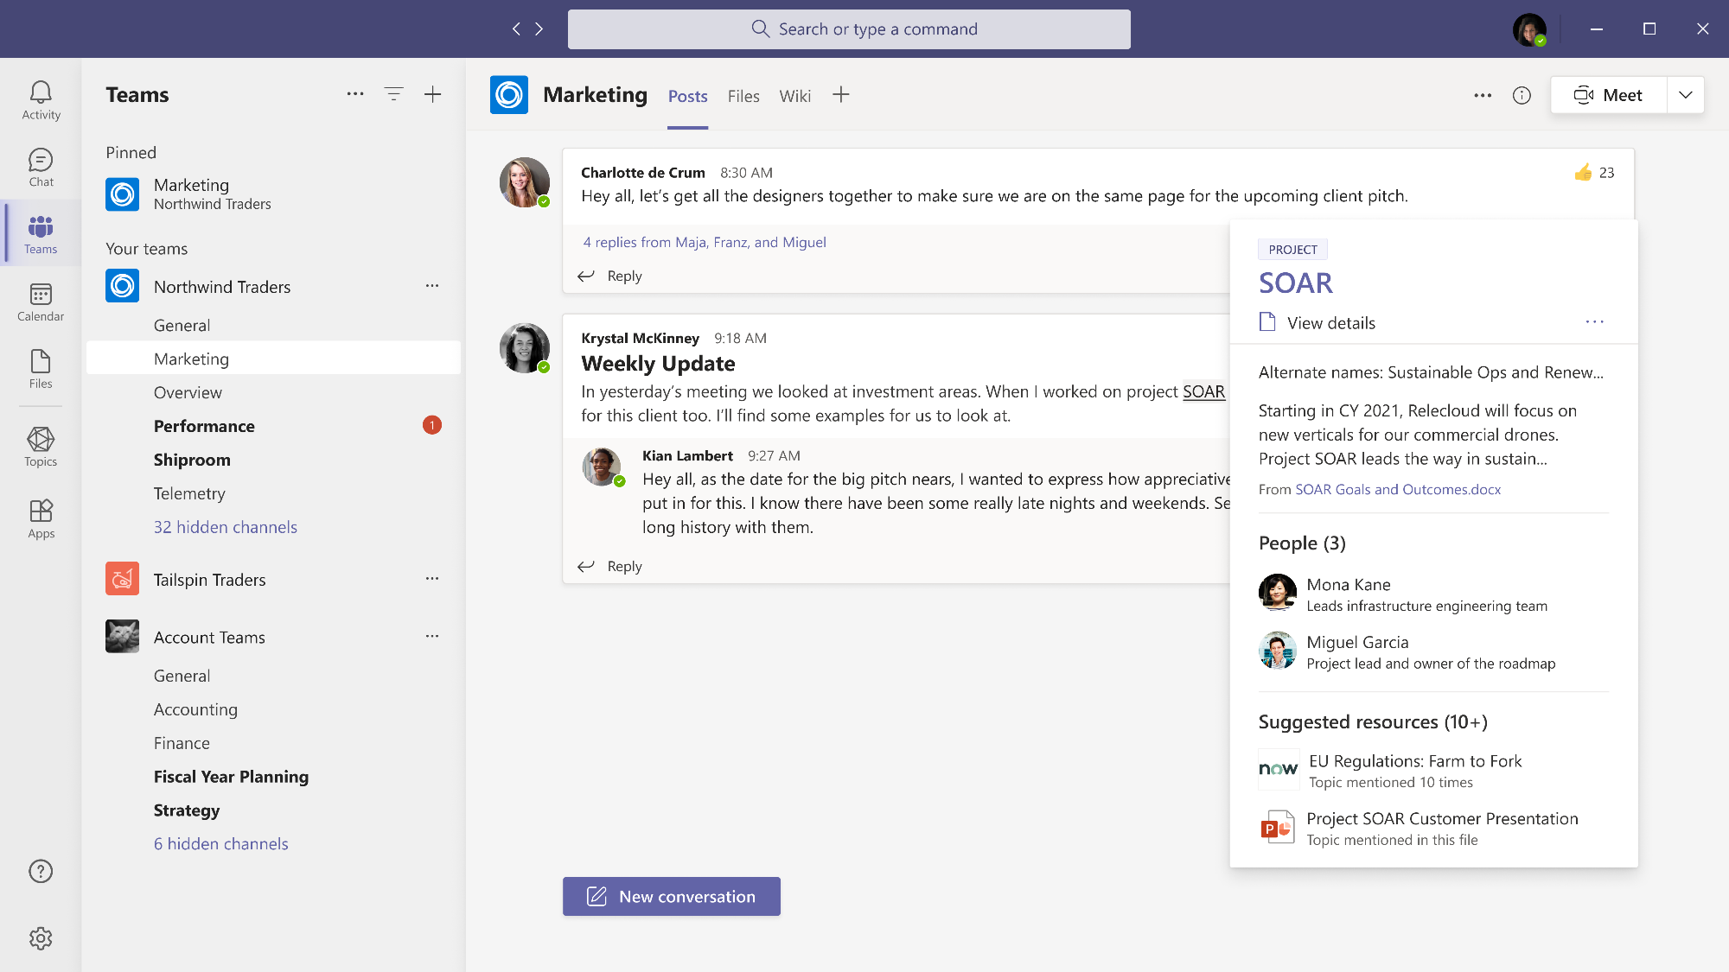

Slide 13
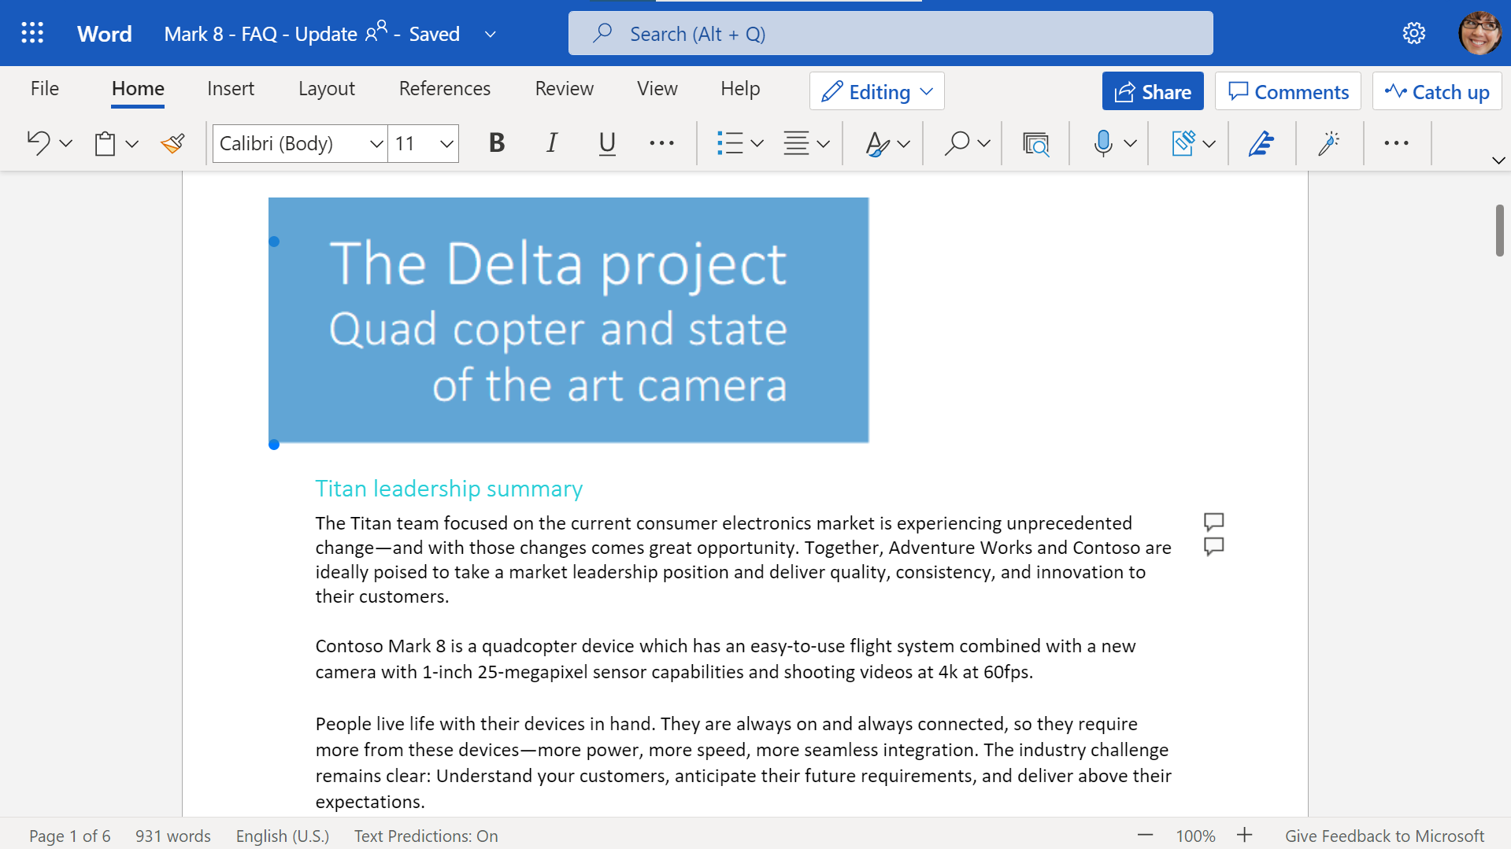

Slide 14
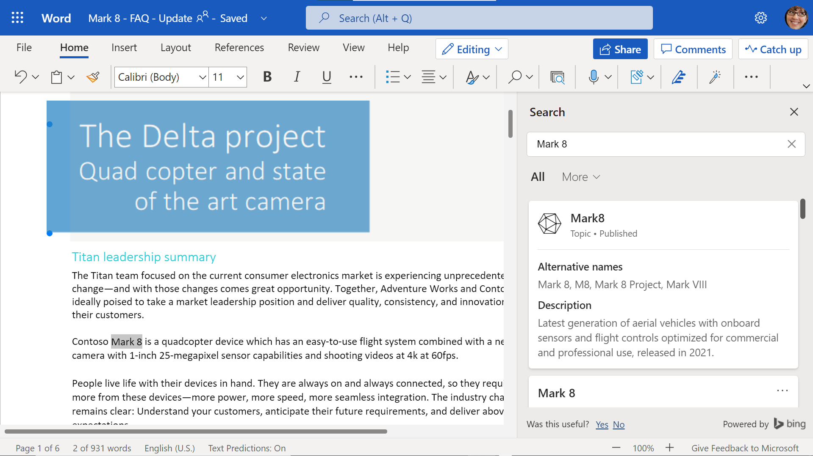

Slide 15
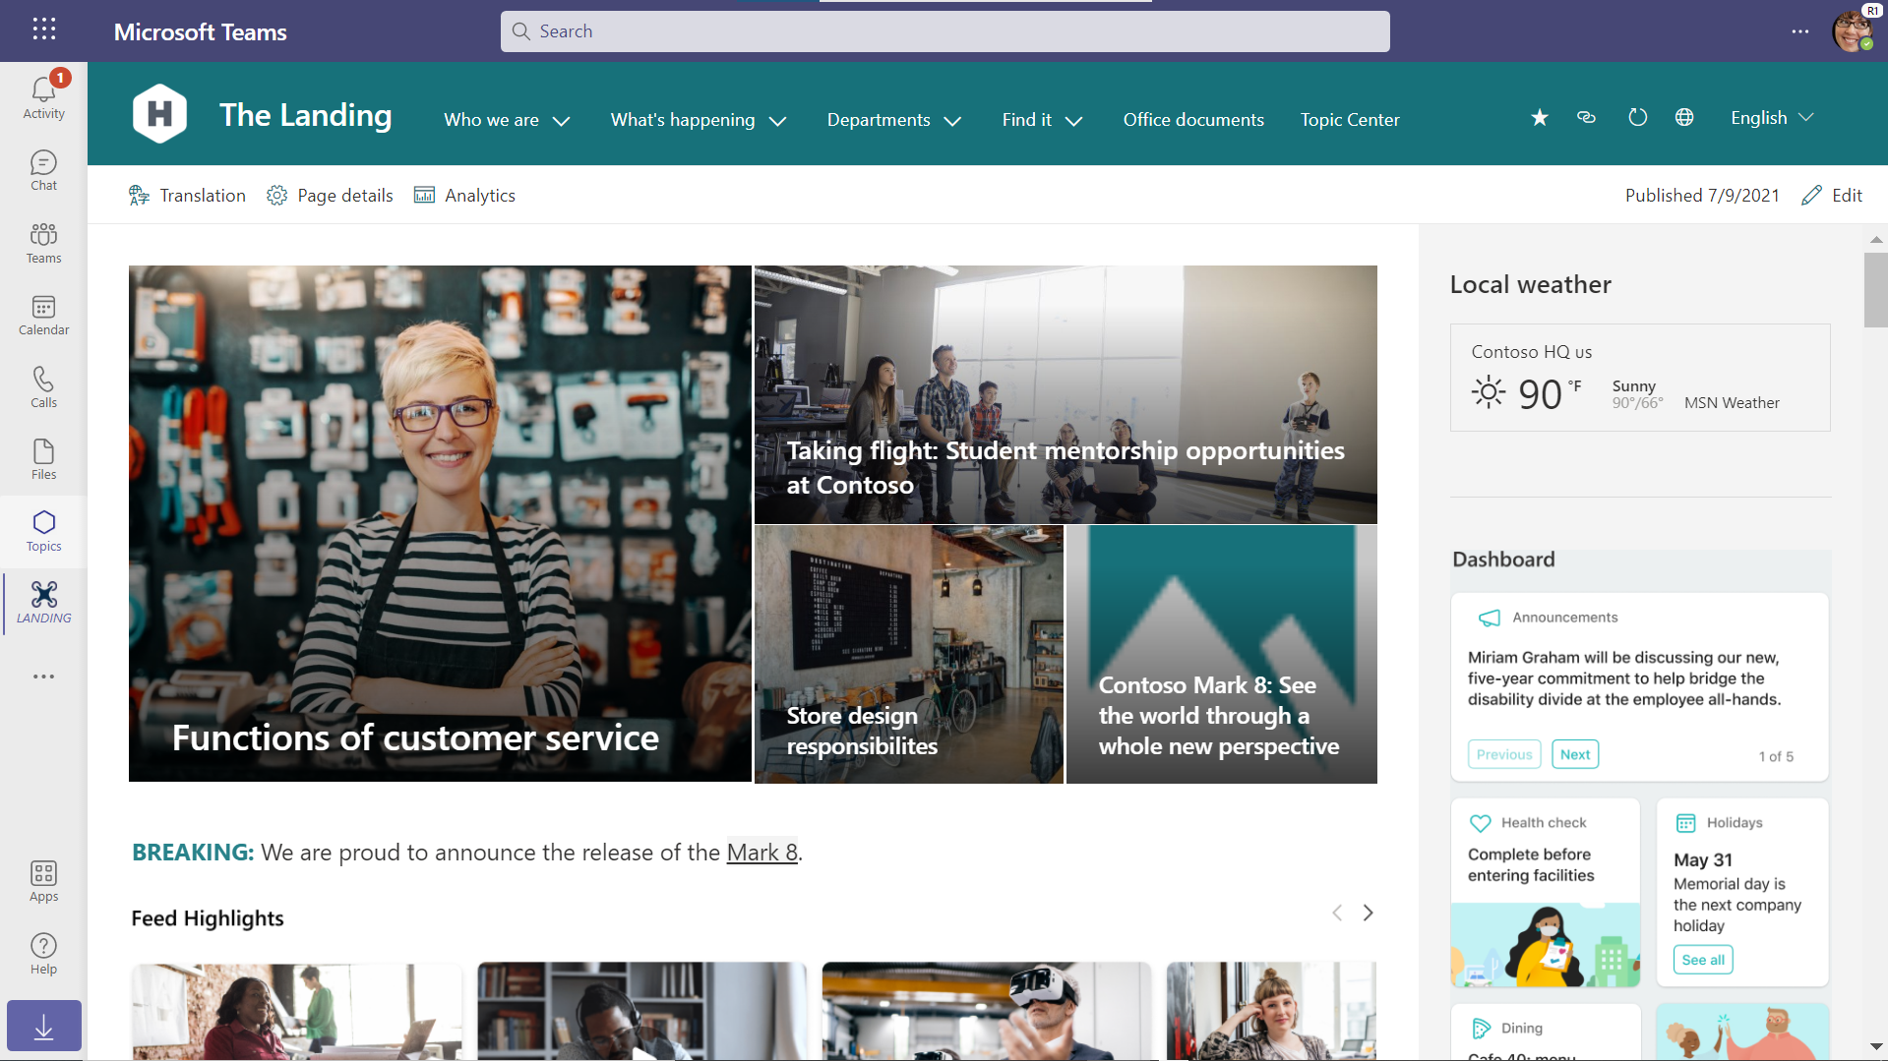

Slide 17
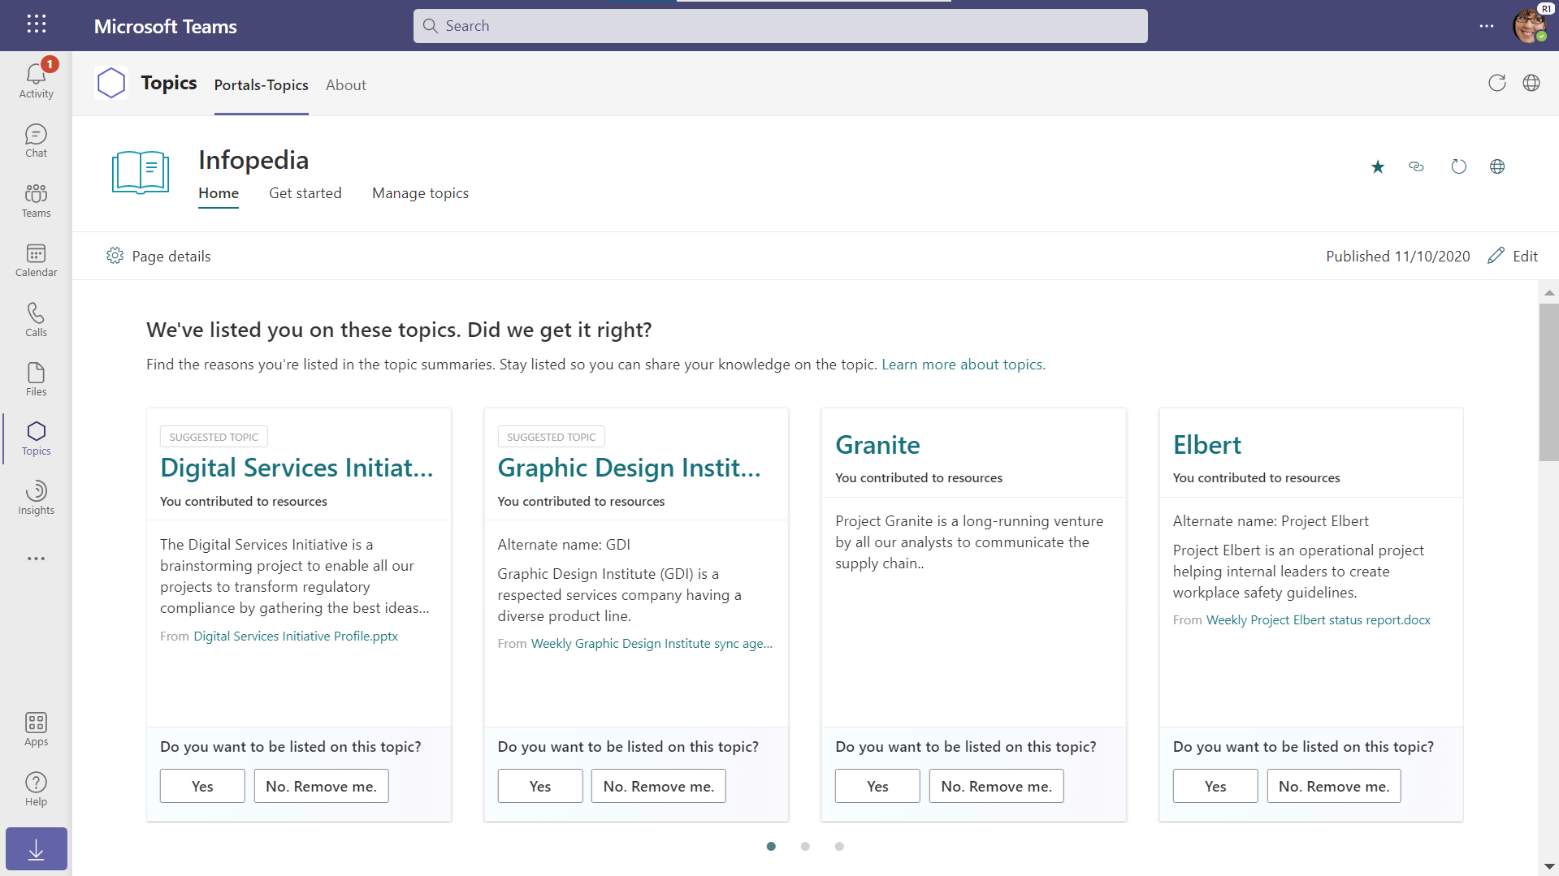

Slide 19
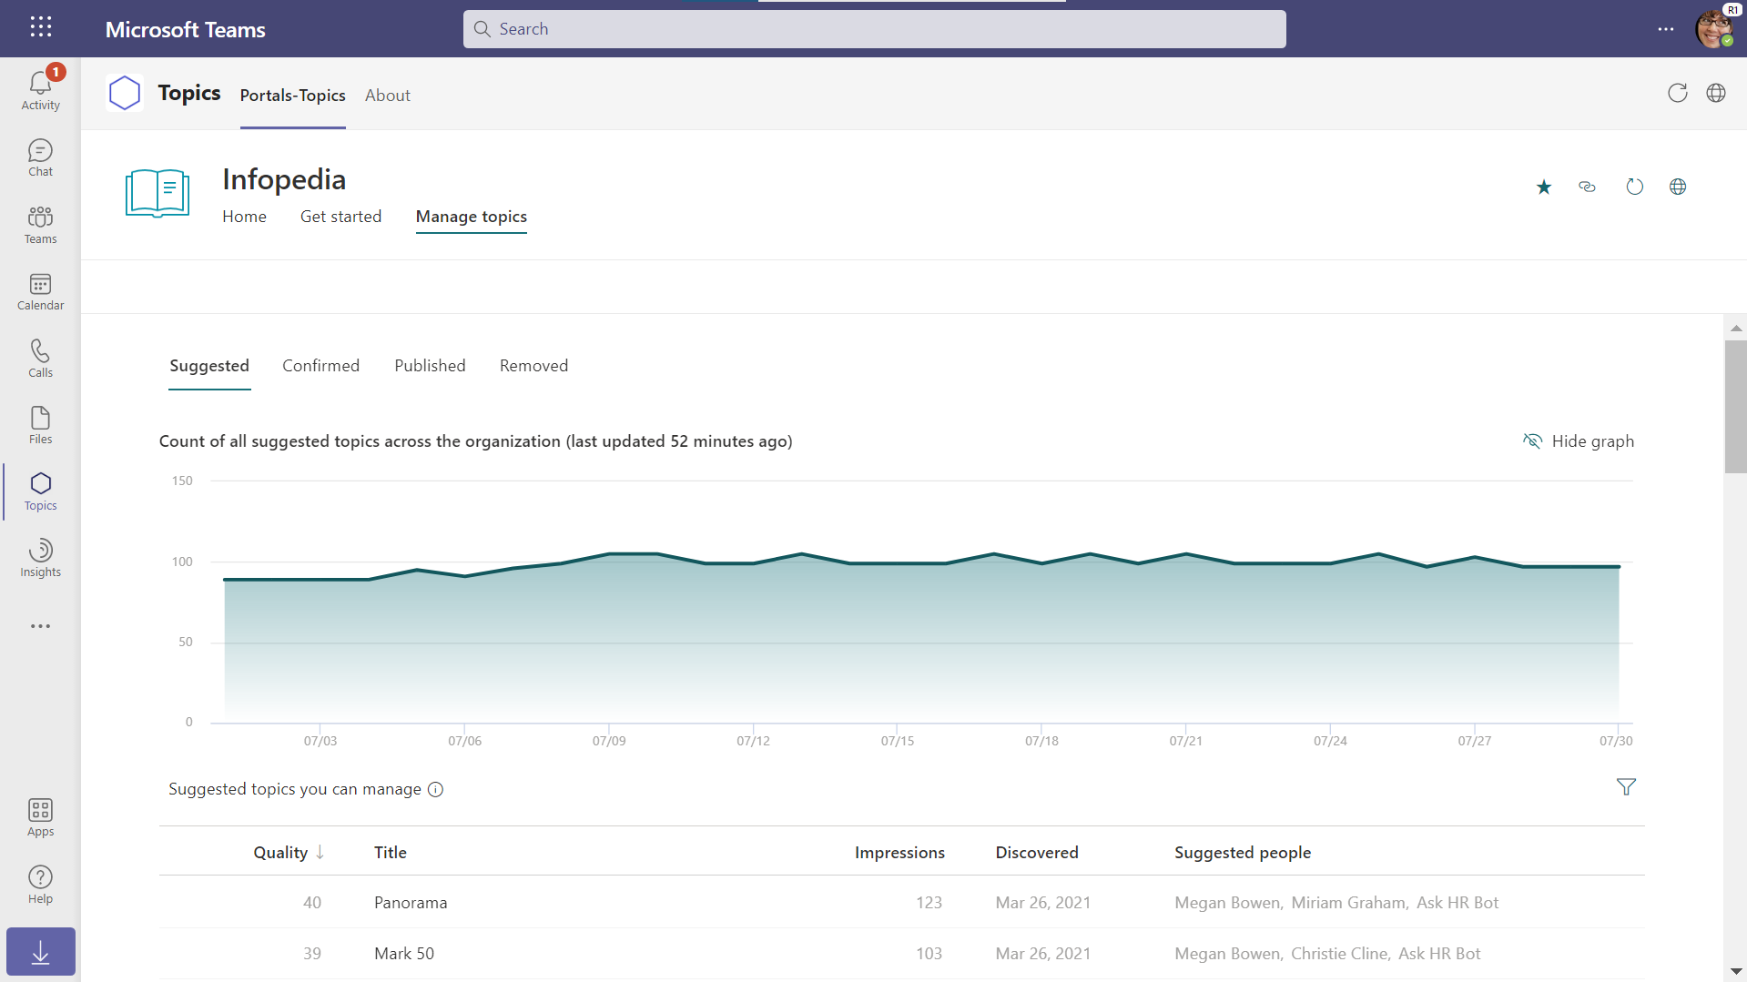

Slide 21
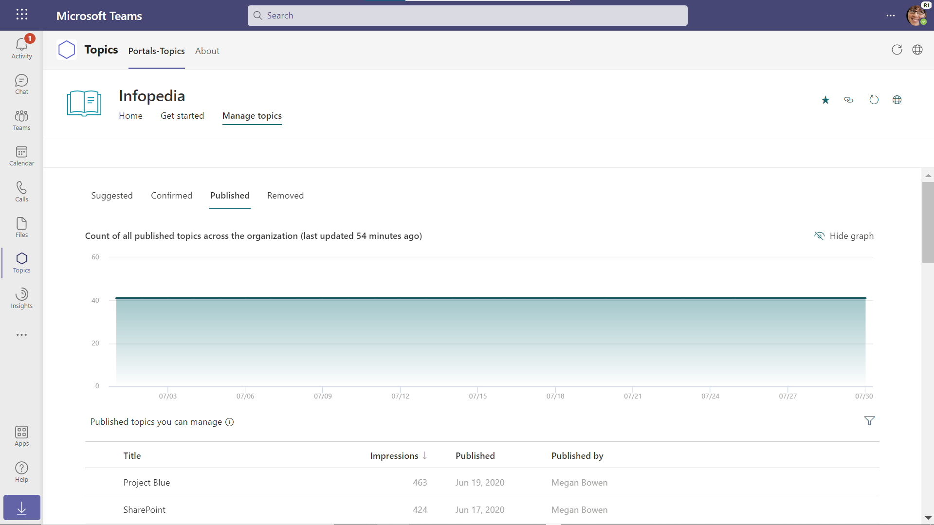

Slide 23
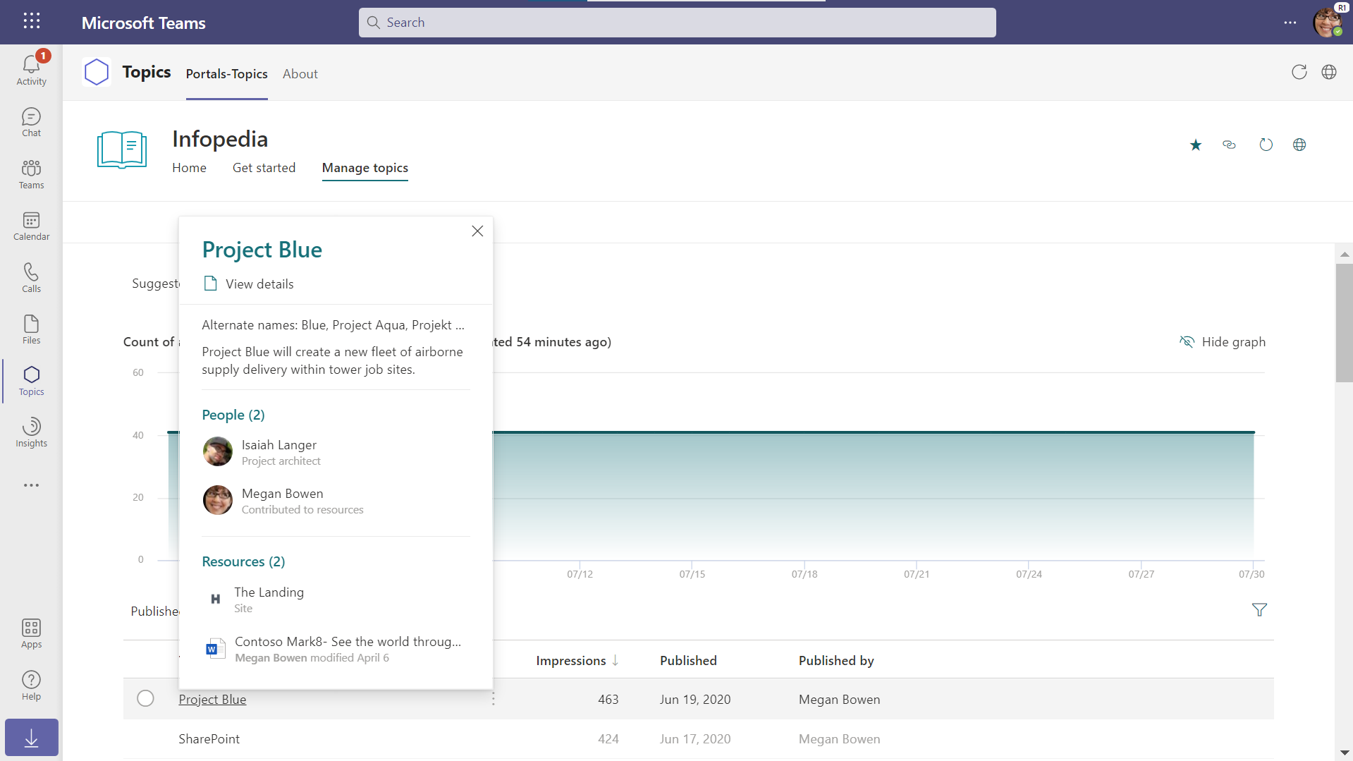

Slide 25
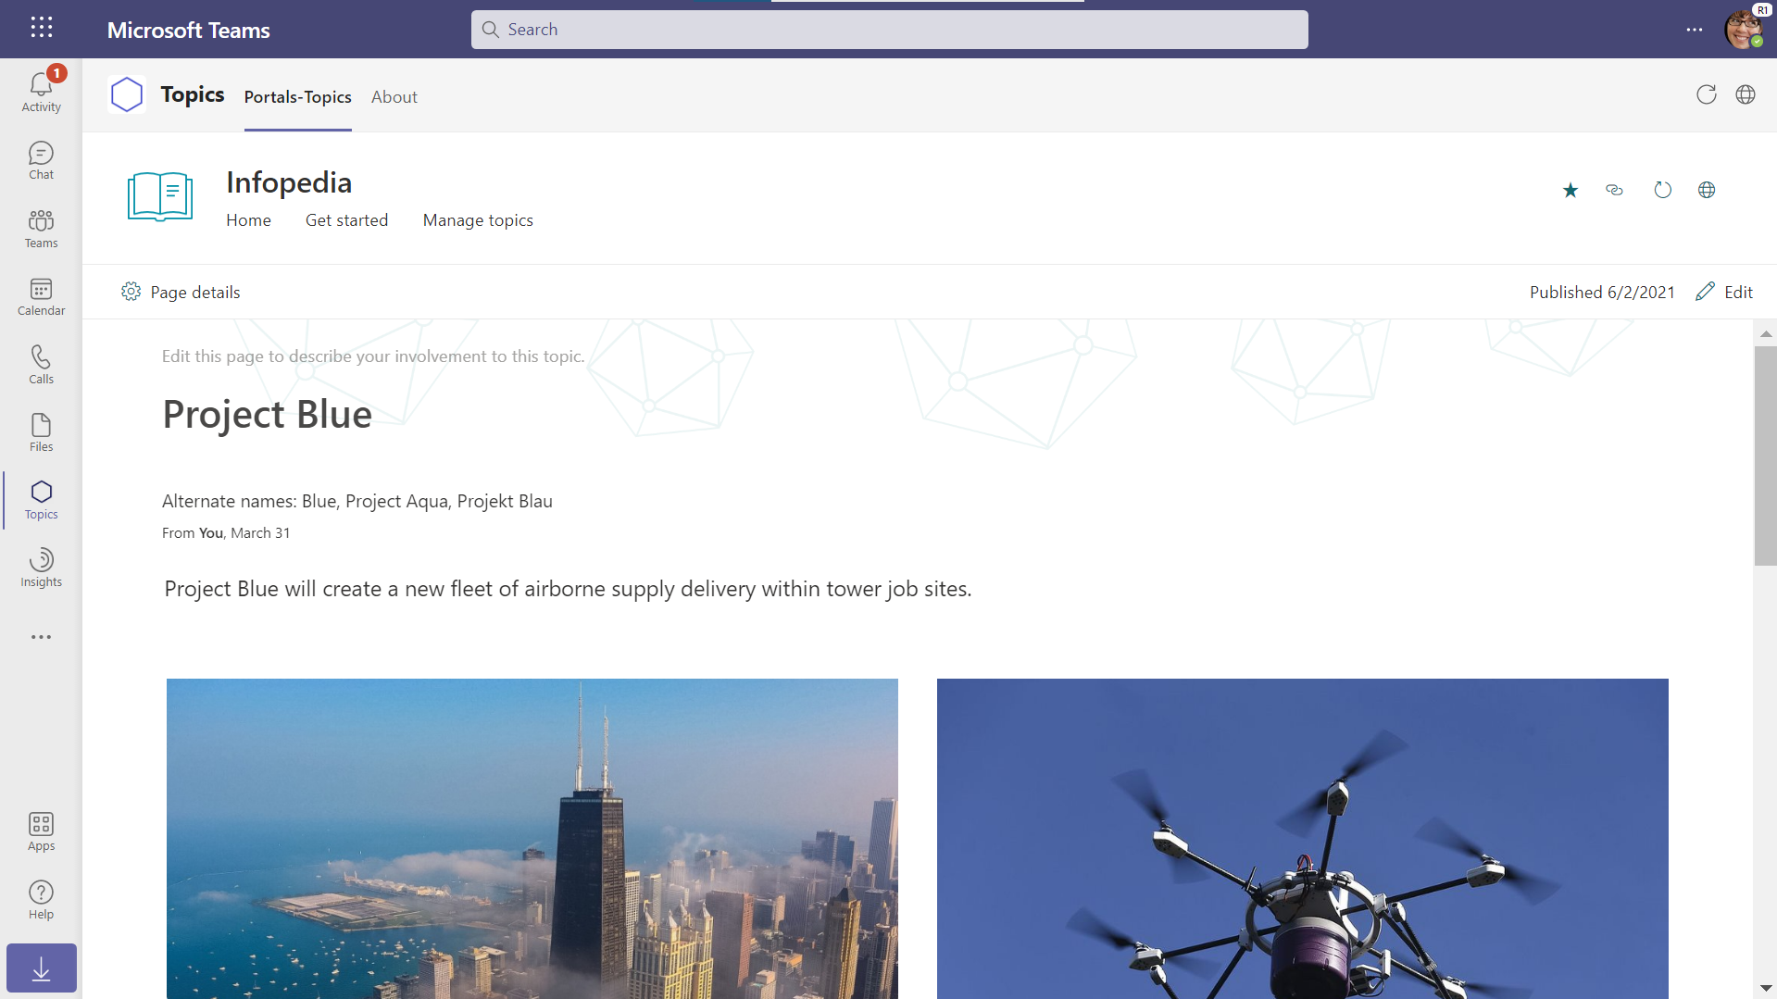

Slide 27
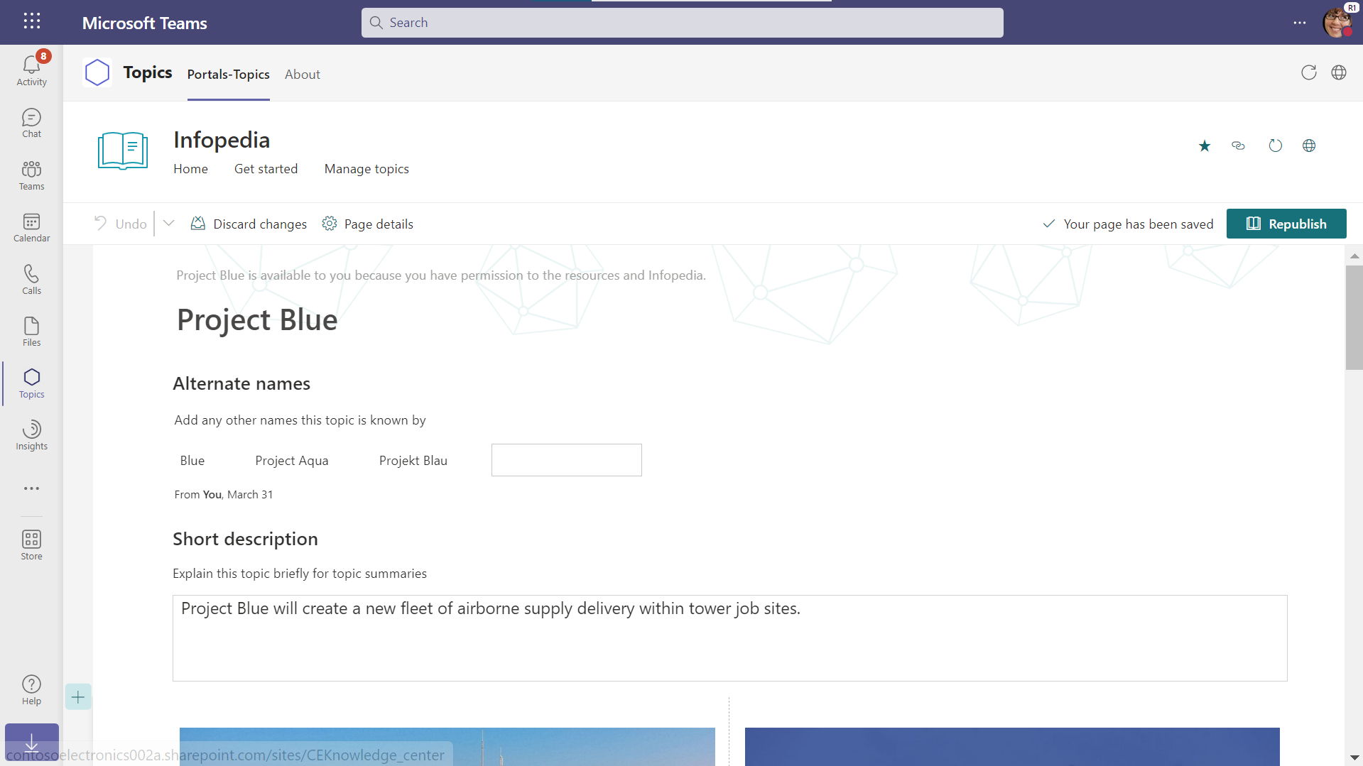

Slide 28
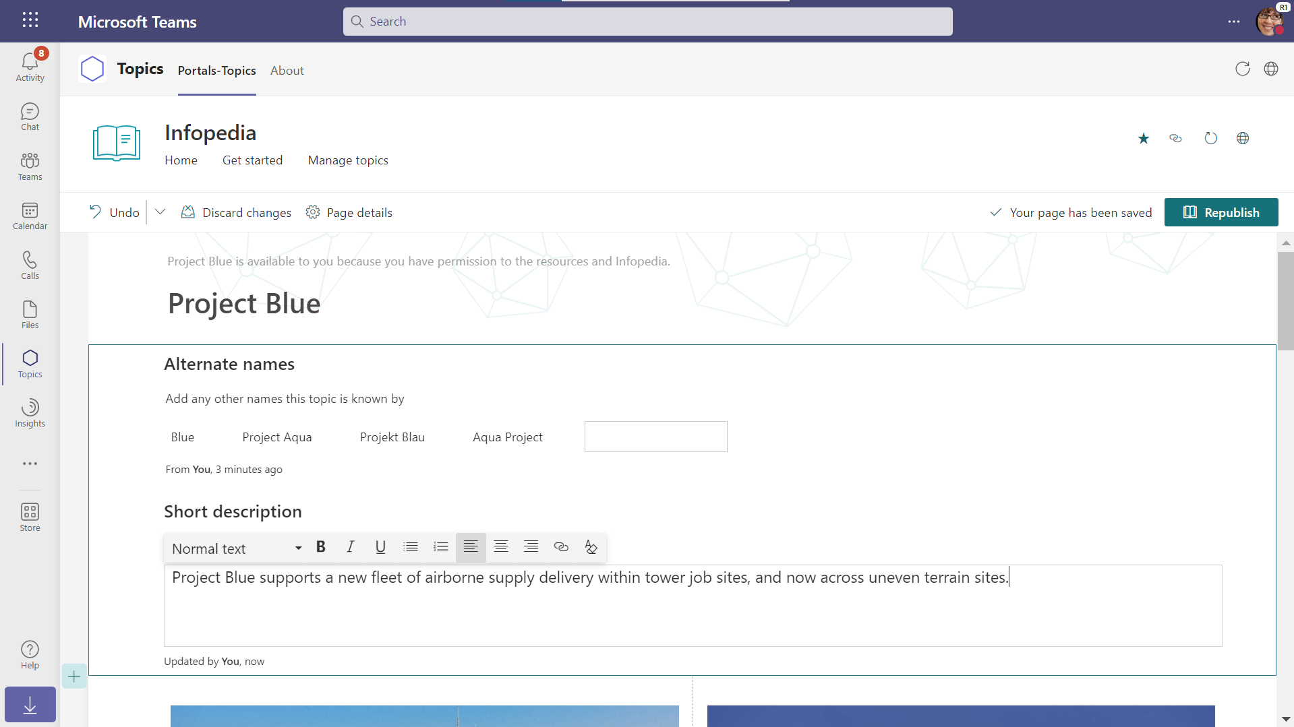

Slide 29
ML challenges posed by the product requirements

Slide 30
Product requirements
. . .
Scale to billions of documents
. . .
Work from available enterprise data
Preserve user privacy
Support multiple geographies
Surface the topics in user experiences
Support multiple languages
. . .
Build topic pages
Support the evolving KB over time
Generalize across tenants
. . .

Slide 31
From product to ML requirements (1)
Work from available enterprise data
Mine from diverse unstructured sources e.g., emails, documents, chats
Link through a subset of the topic properties
Mine from structured sources
e.g., external KBs
Mine from metadata
e.g., recipient, author

Slide 32
From product to ML requirements (2)
Build topic pages
Topics should be concise and structured
Topics should be complete but not over-merged

Slide 33
From product to ML requirements (3)
Surface the topics in user experiences
Topics should be editabled by users
Topics should be browsable and discoverable
i.e., the KB should be materialized
Topics shouldn’t be fragmented
e.g., for highlighting

Slide 34
From product to ML requirements (4)
Preserve user privacy
KB should be constructed automatically
data is eyes-off
Provenance should be tracked
permissions are checked in real time

Slide 35
From product to ML requirements (5)
Support the evolving KB over time
Provide consistent topic referencing over time
e.g., hashtags and page links
Machine learning should be incremental
to achieve required latency for KB freshness

Slide 36
ML requirements
. . .
Support incremental learning
. . .
Support structured and unstructured inputs
Support merging of entity fragments
Maintain stable entity identifiers over time
Support missing values in entity linking
Track provenance
. . .
Prevent both over- and under-merging
Support human in the loop
Construct the KB completely automatically
. . .

Slide 37
A framework to tackle all these requirements

Slide 38
Object-oriented view of the KB
Entity
type
class Event
{
Set<Name> Names Text Description
DateTime Start
DateTime End
Address Location
... ...
}
var akbc2022 = new Event
{
Names = ”AKBC 2022”, “Automated Knowledge…”, …
Start = 3 Nov 2022, 9am
...
}
Probabilistic
property
types
Properties
Entity
Property
values

Slide 39
Probabilistic property types
Toy example
A: “The event took place after Monday”
B: “The event took place before Thursday”
Read
Probabilistic property value parsing from text to a distribution
Write
Text generation from the probability distribution
A:
0 | $$1/6$$ | $$1/6$$ | $$1/6$$ | $$1/6$$ | $$1/6$$ | $$1/6$$
B:
$$1/3$$ | $$1/3$$ | $$1/3$$ | 0 | 0 | 0 | 0
Prior:
$$1/7$$ | $$1/7$$ | $$1/7$$ | $$1/7$$ | $$1/7$$ | $$1/7$$ | $$1/7$$
Prior
Define the prior distribution of the strongly typed values
Distribution over strongly typed values
$Inner product: 1/61/3+1/61/3=$ $1/9$
Inner product
Product:
0 | $$1/2$$ | $$1/2$$ | 0 | 0 | 0 | 0
Element-wise product
* Can work with embeddings, continuous values, etc.

Slide 40
(Partial) architecture
Knowledge base
Entity linking and merging
Entity merging (via element-wise product)
Entity linking (via inner product)
Probabilistic entity fragments
Probabilistic property value parsing
Strongly typed entity fragments
Semantic parsing
Schema mapping
Human curations
e.g., edit, add, remove
Unstructured sources
With metadata / source info
Structured knowledge
E.g., external KB

Slide 41
Generative model of entity linking
Model M1
Model M2
Entity E
Entity E
Entity F
Should B link to A?
(A is already in the KB)
Assuming a factorized model, the heavy lifting is done by the probabilistic property types
Fragment A
Fragment B
Fragment A
Fragment B
Posterior given A
Prior
$$P\left(B|A\right)=\int_{E}{P\left(E|A\right) P\left(B | E\right) }$$
$$P\left(B\right)=\int_{F}{P\left(F\right) P\left(B | F\right)}$$
B overlap with A
B overlap with all entities
$$\frac{P\left(\text{Model}=M1 | B, A\right)}{P\left(\text{Model}=M2 | B\right)}=\frac{P\left(B | A,M1\right)}{P\left(B | M2\right)}×\frac{P(M1)}{P(M2)}$$
overlap ratio
~1/#entities

Slide 42
Future of Alexandria

Slide 43
Alexandria over time
Alexandria
v1
Enterprise Alexandria
Alexandria
vNext
Passive knowledge
Active knowledge

Slide 44
Surfacing knowledge
Passive
Does anyone in our group have machine learning experience?
Active
Here are colleagues who can help with the task you are working on right now.
When is Feature X expected to ship?
Where is the project review meeting?
Who is on the Project Alexandria team?
Here are project resources to work from and example past review decks.
Here are people you might want on your new project team.
Here are remaining activities that need to be done before Feature X ships.

Slide 45
Thanks!

