Slide 1
Challenges and Innovations in Building a Product Knowledge Graph
Xin Luna Dong, Amazon
December, 2017

Slide 2
Product Graph vs. Knowledge Graph

Slide 3
Knowledge Graph Example for 2 Movies
Entity
name
“Robin Wright”
name
starring
mid127
“Robin Wright Penn”
name
name
mid345
“罗宾·怀特”
“Forrest Gump”
starring
directed_by
name
Movie
type
mid128
“Tom Hanks”
type
starring
birth_date
July 9th, 1956
“Larry Crowne”
mid346
name
name
starring
mid129
“Julia Roberts”
Entity type
Relationship
type
Person

Slide 4
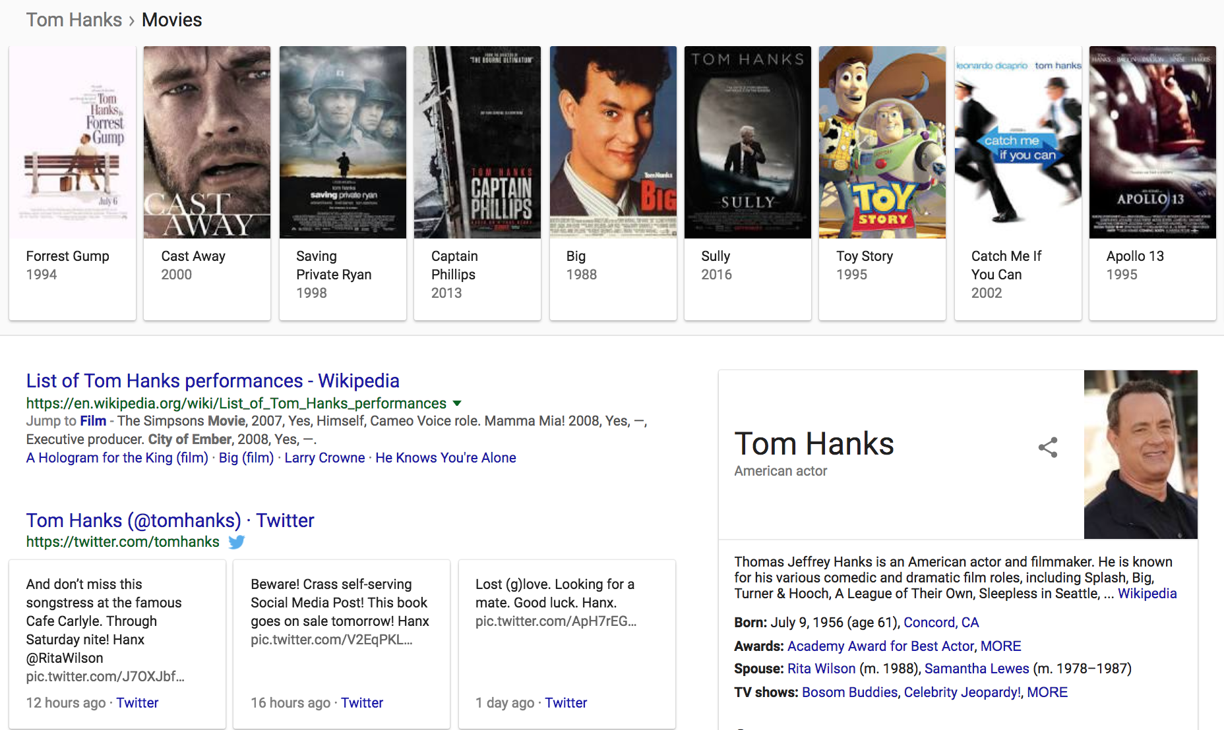
Knowledge Graph in Search

Slide 5
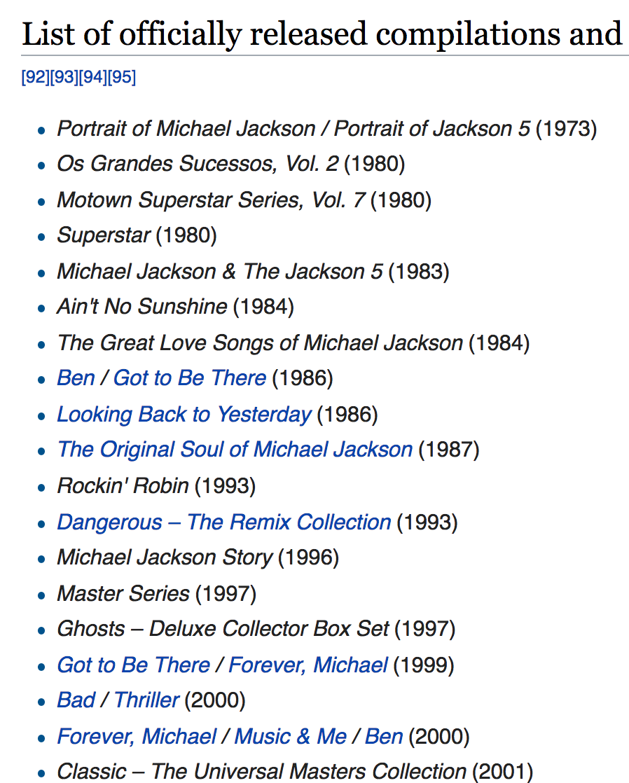
Knowledge Graph in Personal Assistant
Alexa, play the music by Michael Jackson

Slide 6
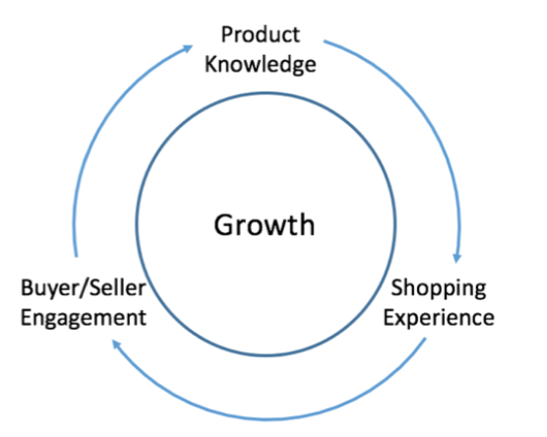
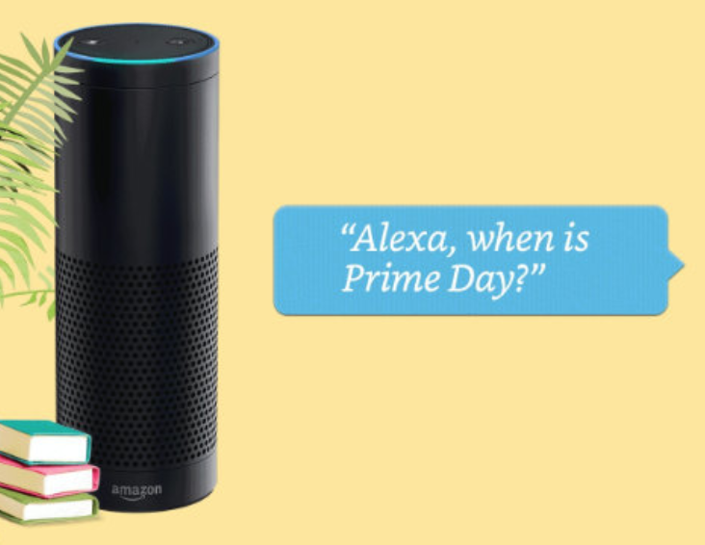
Product Graph
Mission: To answer any question about products and related knowledge in the world

Slide 7
Product Graph vs. Knowledge Graph
(A)
(B)
(C)
Generic KG
Generic KG
Generic KG
PG
PG
PG

Slide 8
Knowledge Graph Example for 2 Movies
name
“Robin Wright”
name
starring
mid127
“Robin Wright Penn”
name
name
mid345
“罗宾·怀特”
“Forrest Gump”
starring
directed_by
name
Movie
type
mid128
“Tom Hanks”
type
starring
birth_date
July 9th, 1956
“Larry Crowne”
mid346
name
name
starring
mid129
“Julia Roberts”
type
Person

Slide 9
Product Graph vs. Knowledge Graph
name
“Robin Wright”
“Forrest Gump”
name
name
starring
mid127
“Robin Wright Penn”
name
mid345
“罗宾·怀特”
starring
directed_by
name
mid128
“Tom Hanks”
starring
birth_date
July 9th, 1956
mid346
mid129
name
name
starring
“Julia Roberts”
“Larry Crowne”
type
Person

Slide 10
Product Graph vs. Knowledge Graph
B0035QUXWQ
name
“Robin Wright”
“Forrest Gump”
ASIN
mid567
name
B0035QUXWR
name
starring
mid127
“Robin Wright Penn”
ASIN
product
name
Digital Movie
type
mid568
mid345
“罗宾·怀特”
product
starring
directed_by
name
DVD
mid569
mid128
“Tom Hanks”
product
Blu-ray
type
starring
birth_date
July 9th, 1956
mid570
product
mid346
ASIN
product
mid129
name
B0067XLIG8
name
starring
“Julia Roberts”
ASIN
mid571
B0067XLIG4
“Larry Crowne”
type
Person

Slide 11
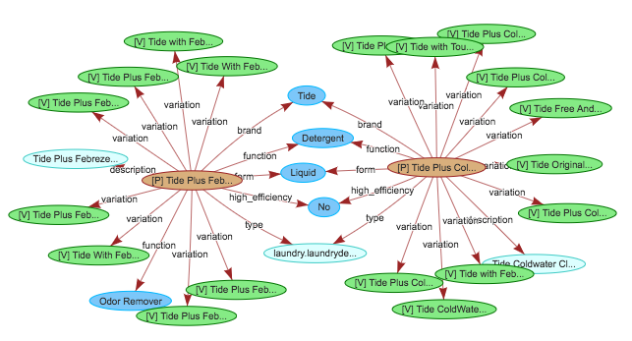
Another Example of Product Graph

Slide 12
Knowledge Graph vs. Product Graph
(A)
(B)
✓
(C)
Generic KG
Generic KG
Generic KG
PG
(Movie, Music, Book)
Product
Graph
Movie,
Music,
Book,
etc.
PG

Slide 13
But, Is The Problem Harder?
Generic KG
Product
Graph
Movie,
Music,
Book,
etc.

Slide 14
Challenges in Building Product Graph I
No major sources to curate product knowledge from
Wikipedia does not help too much
A lot of structured data buried in text descriptions in Catalog
Retailers gaming with the system so noisy data

Slide 15
Challenges in Building Product Graph II
Large number of new products everyday
Curation is impossible
Freshness is a big challenge

Slide 16
Challenges in Building Product Graph III
Large number of product categories
A lot of work to manually define ontology
Hard to catch the trend of new product categories and properties

Slide 17
How to Build a Product Graph?

Slide 18
Where is Knowledge from?
Product Graph

Slide 19
Architecture
Querying
Graph
Mining
Embedding
Generation
Recommen-dation
Search, QA, Conversation
Graph
Applications
Product Graph
Graph
Construction
Schema
Mapping
Entity
Resolution
Knowledge
Cleaning
Knowledge
Cleaning
Ontology
Ingestion
Web
Extraction
Catalog
Extraction
Knowledge
Collection

Slide 20
Which ML Model Works Best?

Slide 21
Which ML Model Works Best?
Tree-based models
??
Neural network

Slide 22
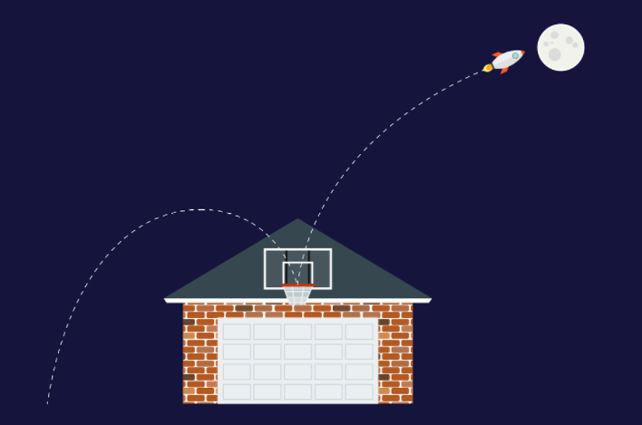
Research Philosophy
Moonshots: Strive to apply and invent the state-of-the-art
Roofshots: Deliver incrementally and make production impacts

Slide 23
I. Integrating Knowledge from Structured Sources
Querying
Graph
Mining
Embedding
Generation
Recommen-dation
Search, QA, Conversation
Graph
Applications
Product Graph
Graph
Construction
Schema
Mapping
Entity
Resolution
Knowledge
Cleaning
Knowledge
Cleaning
Ontology
Ingestion
Web
Extraction
Catalog
Extraction
Knowledge
Collection

Slide 24
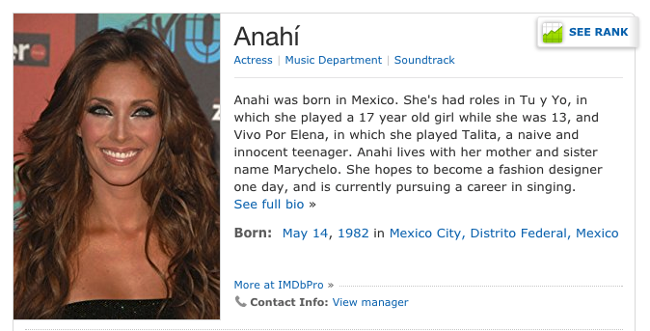
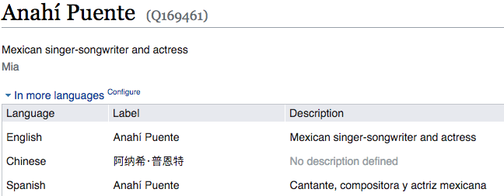
Challenges: Linkage & Quality
IMDB
WikiData
Same entity?
Which BirthDate is correct?

Slide 25
Challenges: Linkage
B0035QUXWQ
name
“Robin Wright”
“Forrest Gump”
ASIN
mid567
name
B0035QUXWR
name
starring
mid127
“Robin Wright Penn”
ASIN
product
name
Digital Movie
type
mid568
mid345
“罗宾·怀特”
product
starring
directed_by
name
DVD
mid569
mid128
“Tom Hanks”
product
Blu-ray
type
starring
birth_date
July 9th, 1956
mid570
product
mid346
ASIN
product
mid129
name
B0067XLIG8
name
starring
“Julia Roberts”
ASIN
mid571
B0067XLIG4
“Larry Crowne”
type
Person

Slide 26
I. Integrating Knowledge from Structured Sources
Querying
Graph
Mining
Embedding
Generation
Recommen-dation
Search, QA, Conversation
Graph
Applications
Product Graph
Graph
Construction
Schema
Mapping
Entity
Resolution
Knowledge
Cleaning
Knowledge
Cleaning
Ontology
Ingestion
Web
Extraction
Catalog
Extraction
Knowledge
Collection

Slide 27
I. Integrating Knowledge from Structured Sources
Querying
Graph
Mining
Embedding
Generation
Recommen-dation
Search, QA, Conversation
Graph
Applications
Product Graph
Graph
Construction
Schema
Mapping
Entity
Resolution
Knowledge
Cleaning
Knowledge
Cleaning
Ontology
Ingestion
Web
Extraction
Catalog
Extraction
Knowledge
Collection

Slide 28
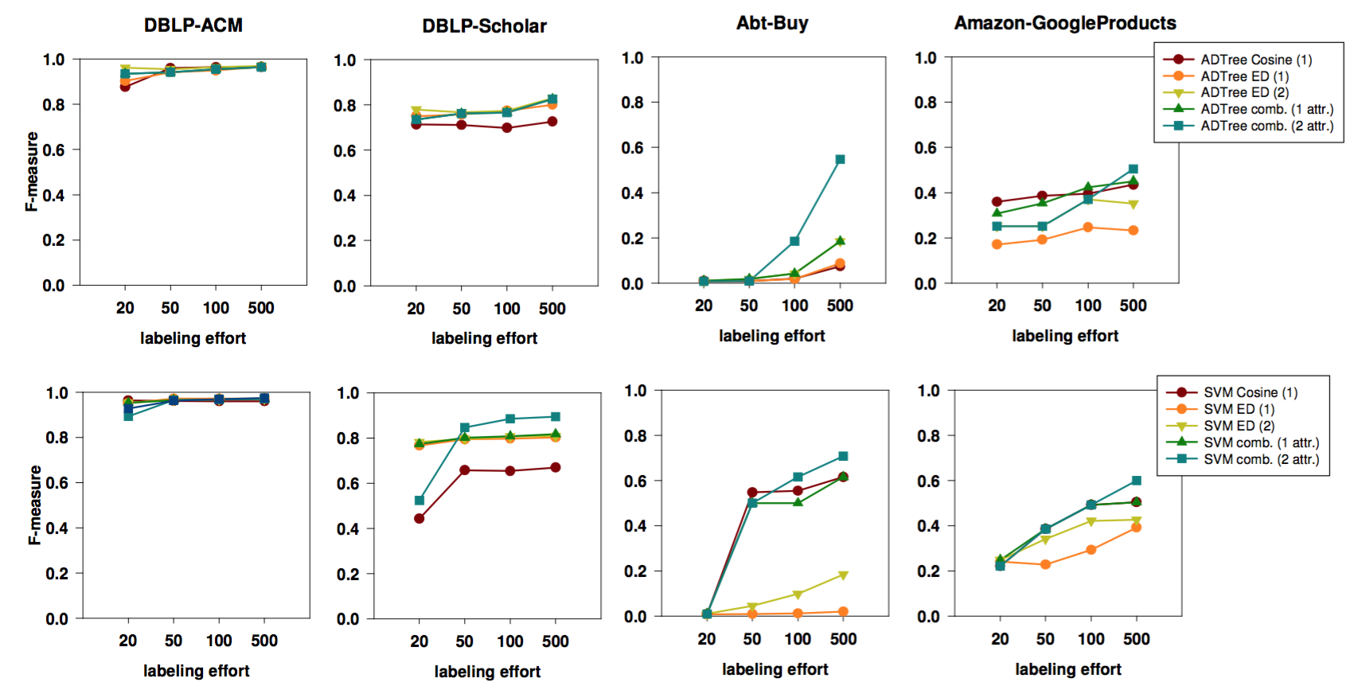
I. Integrating Knowledge from Structured Sources—Entity Resolution
Published results
[Köpcke et al, VLDB 2010]
[Das et al, Sigmod 2017]

Slide 29
I. Integrating Knowledge from Structured Sources—Entity Resolution
Our method:
Model: Random forest
Attribute similarity: various string similarity, number similarity

Slide 30
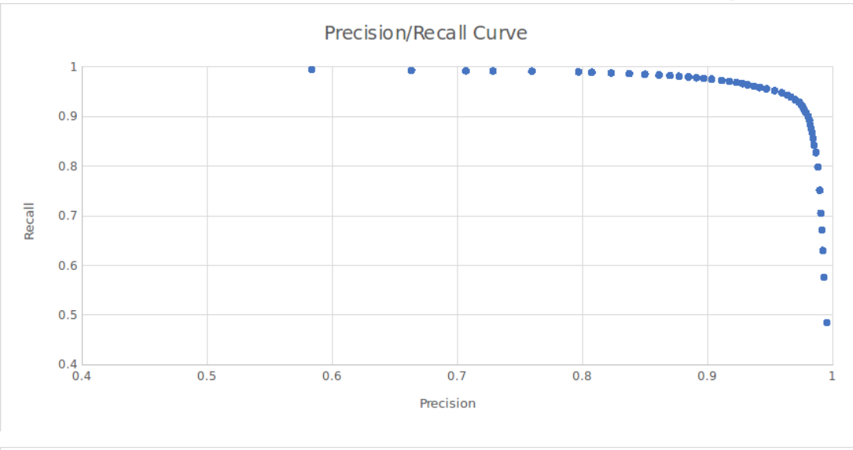
I. Integrating Knowledge from Structured Sources—Entity Resolution
Our method: Random forest on attribute-wise similarity
Results between Freebase and IMDb: AUPRC=0.9856 (1.5K labels)
1.5M labels
 | Precision | Recall
Movie | 99.0% | 98.7%
People | 99.3% | 99.6%

Slide 31
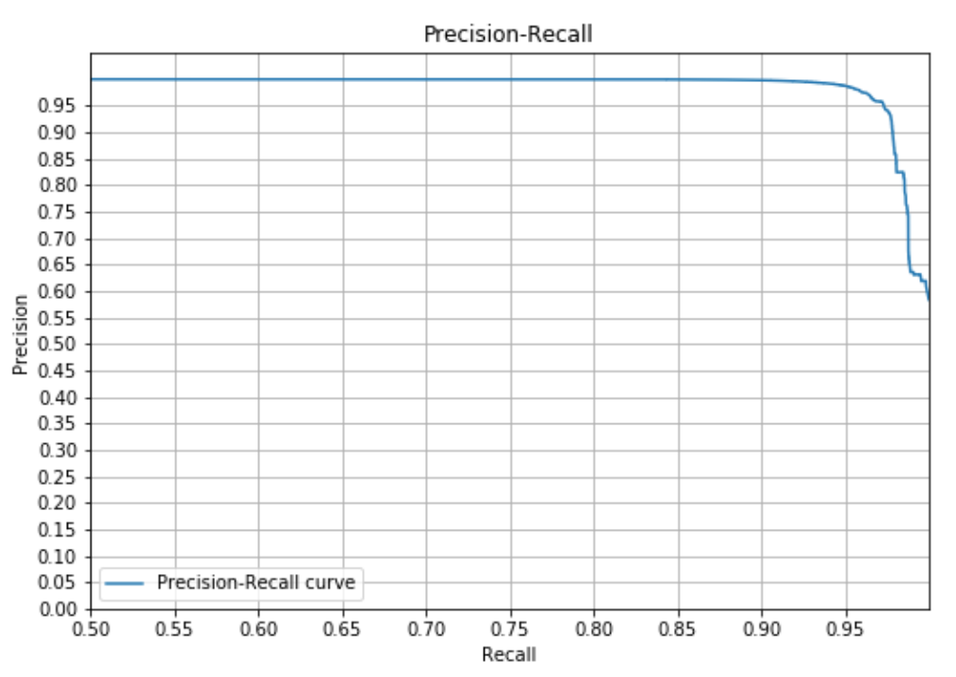
I. Integrating Knowledge from Structured Sources—Entity Resolution
Our method: Random forest on attribute-wise similarity
Results between Amazon Movies and IMDb:
200K labels
~150 features
AUPRC=0.9923
Prec=0.982, Rec=0.951

Slide 32
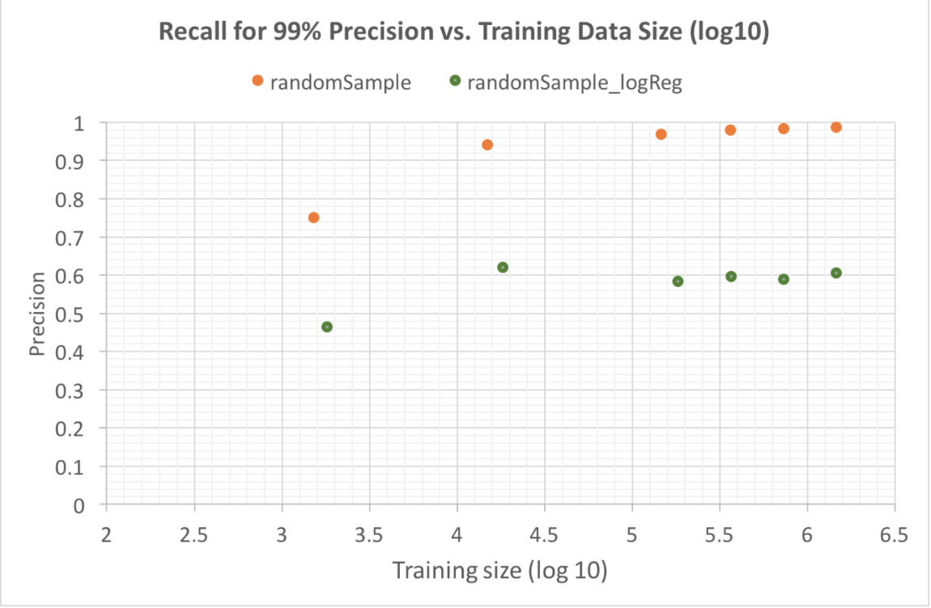
I. Integrating Knowledge—Entity Resolution Which ML Model Works Best?
Logistic regression: Prec=0.99, Rec=0.6
Random forest: Prec=0.99, Rec=0.99
Amazon Confidential

Slide 33
I. Integrating Knowledge—Entity Resolution Which ML Model Works Best?
Logistic regression: Prec=0.99, Rec=0.6
Random forest: Prec=0.99, Rec=0.99
XGBoost: Marginally better, but sensitive to hyper-parameters
Neural network: Similar performance

Slide 34
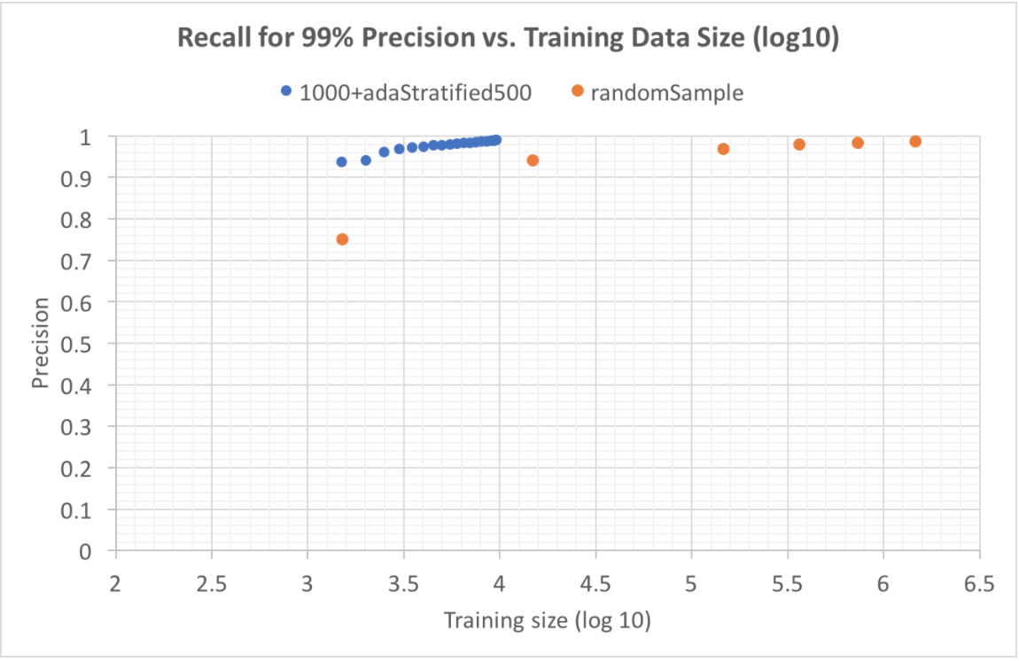
I. Integrating Knowledge from Structured Sources—Entity Resolution
Moonshot: Apply active learning to minimize #labels
For 99% precision and recall, active learning reduces
#labels by 2 orders of magnitude
With 15K labels we get prec=99% and rec=~95% (30 labelers for 1 week!)
Reaching prec=99% and rec=~99% requires 1.5M labels
Amazon Confidential

Slide 35
I. Integrating Knowledge from Structured Sources—Entity Resolution
Moonshots: Seamless incremental graph linkage with high precision and recall
Freebase
IMDb
Wikipedia
Wikidata
Netflix
Different sources have different characteristics, but share commonalities from the same domain
How to leverage models for existing sources on new sources?

Slide 36
I. Integrating Knowledge from Structured Sources—Entity Resolution
Moonshots: Seamless incremental graph linkage with high precision and recall
Freebase
IMDb
Wikipedia
Wikidata
Netflix
A complex space can contain tens to thousands of different types and linkage on different types of entities can affect each other
How to avoid manual scheduling for linkage?

Slide 37
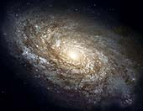
I. Integrating Knowledge from Structured Sources—Entity Resolution
Moonshots: Seamless incremental graph linkage with high precision and recall
New
data
New
data
New
data
New
data
New
data
Freebase
IMDb
Wikipedia
Wikidata
Netflix
New data are arriving over time, requiring incremental linkage and model evolution
How to perform incremental linkage and evolve the model?

Slide 38
II. Extracting Knowledge from Semi-Structured Data on the Web
Querying
Graph
Mining
Embedding
Generation
Recommen-dation
Search, QA, Conversation
Graph
Applications
Product Graph
Graph
Construction
Schema
Mapping
Entity
Resolution
Knowledge
Cleaning
Knowledge
Cleaning
Ontology
Ingestion
Web
Extraction
Catalog
Extraction
Knowledge
Collection

Slide 39
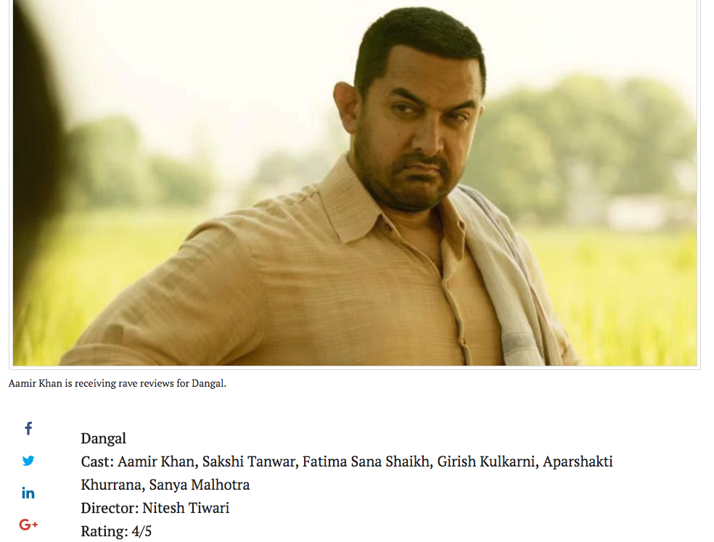
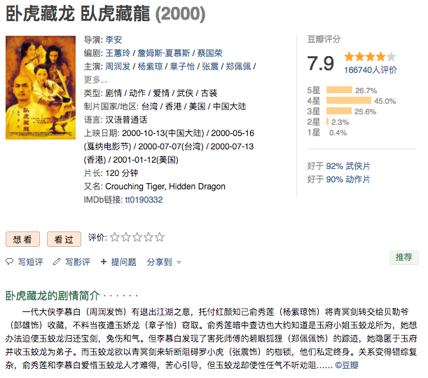
II. Extracting Knowledge from Semi-Structured Data on the Web

Slide 40
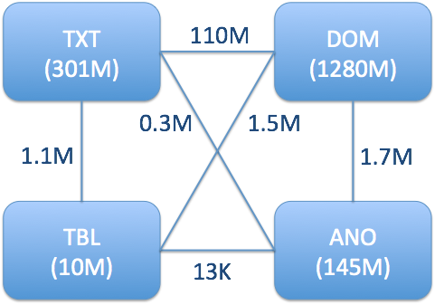
II. Extracting Knowledge from Semi-Structured Data on the Web
Knowledge Vault @ Google showed big potential from DOM-tree extraction [Dong et al., KDD’14][Dong et al., VLDB’14]

Slide 41
II. Extracting Knowledge from Web—Distantly Supervised DOM Extraction
Entity
Identification
Automatic
Annotation
Training
Automatic Label Generation
Movie entity
Genre
Release Date
Extracted triples
(Top Gun, type.object.name, “Top Gun”)
(Top Gun, film.film.genre, Action)
(Top Gun, film.film.directed_by, Tony Scott)
(Top Gun, film.film.starring, Tom Cruise)
(Top Gun, film.film.runtime, “1h 50min”)
(Top Gun, film.film.release_Date_s, “16 May 1986”)
Runtime
Director
Actors

Slide 42
II. Extracting Knowledge from Web—Distantly Supervised DOM Extraction
Very high extraction precision
Extracting triples with new entities
Extraction on IMDb
Predicate | Precision | Recall
Type.object.name (“name”) | 1 | 1
People.person.place_of_birth | 1 | 1
Common.topic.alias | 1 | 1
Film.actor.film | 0.98 | 0.47
Film.director.film | 0.98 | 0.91
Film.producer.film | 0.89 | 0.57
Film.writer.film | 0.96 | 0.60
Predicate | Precision | Recall
Type.object.name (“title”) | 0.97* | 0.97*
Tv.tv_series_episode.episode_number | 1 | 1
Tv.tv_series_episode.season_number | 1 | 1
Film.film.directed_by | 0.99 | 1
Film.film.written_by | 1 | 0.98
Film.film.genre | 0.90* | 1
Film.film.starring | 1 | 0.97
Tv.tv_series_episode.series | 1 | 1
*Ground truth is incomplete. Manual inspection suggests close to 100% accuracy.
Notes:
Change the numbers here

Slide 43
II. Extracting Knowledge from Web—Distantly Supervised DOM Extraction
Extraction experiments on http://swde.codeplex.com/ (2011)
 | Title |  | Director(s) |  | Genre(s)
Site | P | R | P | R | P | R
allmovies | 1 | 1 | 1 | 1 | N/A | 0
amctv | 1 | 1 | 0.97 | 0.97 | 0.7 | 1
boxofficemojo | 1 | 1 | 1 | 1 | 1 | 1
hollywood | 1 | 1 | 0.99 | 0.99 | 1 | 1
iheartmovies | 1 | 1 | 1 | 1 | 1 | 1
IMDB | 1 | 1 | 1 | 0.99 | 1 | 1
metacritic | 1 | 1 | 1 | 1 | 1 | 1
MSN | 1 | 1 | 1 | 1 | 1 | 1
rottentomatoes | 1 | 1 | 1 | 1 | 1 | 1
yahoo | 1 | 1 | 1 | 0.97 | 0.8 | 0.02
Notes:
Change the numbers here

Slide 44
II. Distantly Supervised DOM Extraction Which ML Model Works Best?
Logistic regression: Best results (20K features on one website)
Random forest: lower precision and recall

Slide 45
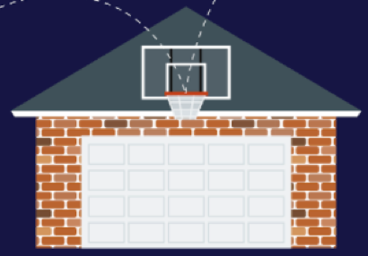
II. Extracting Knowledge from Web—Distantly Supervised DOM Extraction
Nearly-automatic interactive extraction on any new vertical
OpenIE DOM extraction
Distantly supervised web extraction
Annotation-based knowledge extraction
Notes:
Galaxy

Slide 46
III. Extracting Knowledge from Product Profiles in Amazon Catalog
Querying
Graph
Mining
Embedding
Generation
Recommen-dation
Search, QA, Conversation
Graph
Applications
Product Graph
Graph
Construction
Schema
Mapping
Entity
Resolution
Knowledge
Cleaning
Knowledge
Cleaning
Ontology
Ingestion
Web
Extraction
Catalog
Extraction
Knowledge
Collection

Slide 47
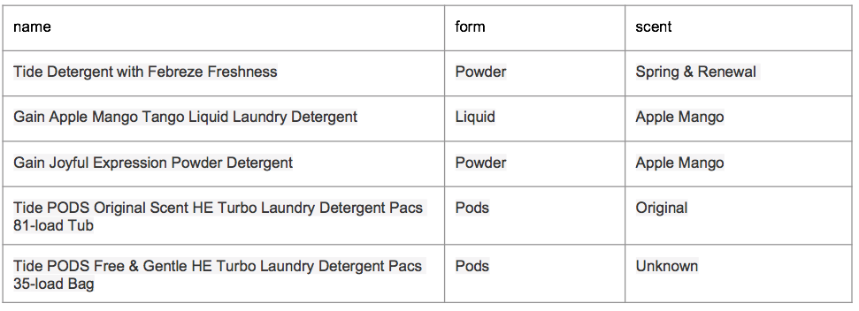
III. Extracting Knowledge from Product Profiles in Amazon Catalog
Notes:
Change the numbers here

Slide 48
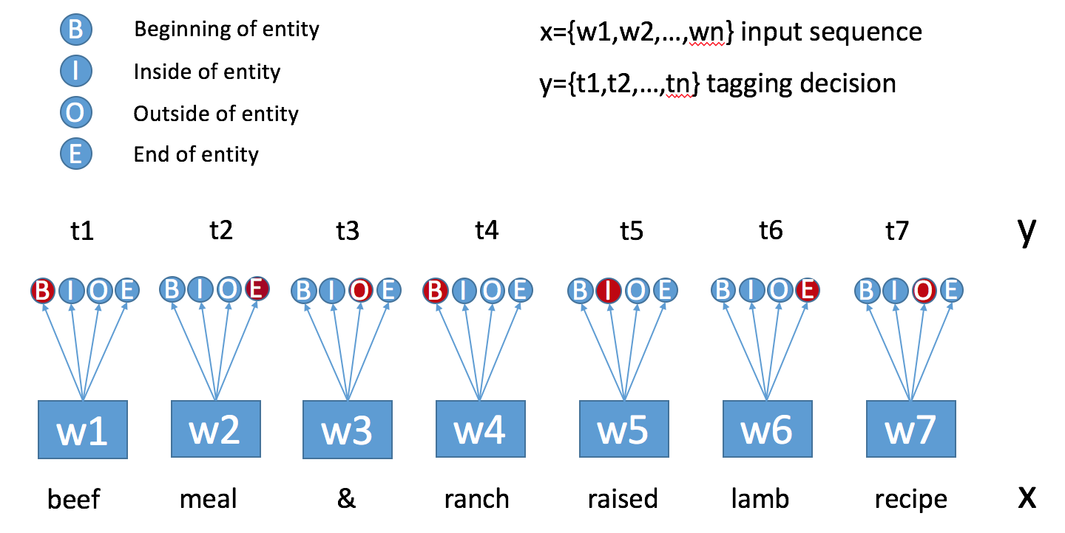
III. Product Profile Extraction by Named Entity Recognition
Notes:
Change the numbers here

Slide 49
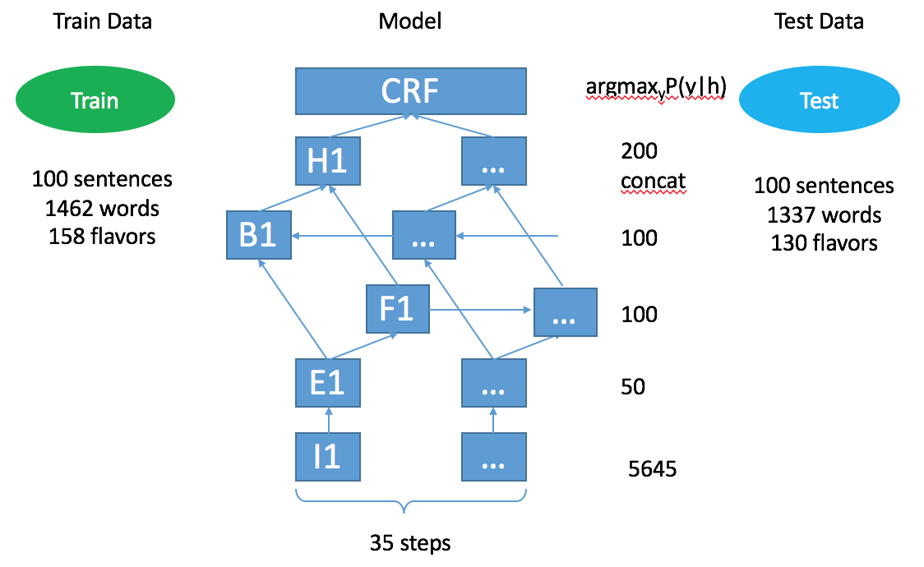
III. Product Profile Extraction by Named Entity Recognition
BiLSTM+CRF
Different flavors from Training data
Notes:
Change the numbers here

Slide 50
III. Product Profile Extraction by Named Entity Recognition
How well can we do on new values?
 | True Flavor | False Flavor | Missing Flavor | Precision | Recall
String Match (with unknown values) | 448 | 187 | 338 | 70.6% | 57.0%
BiLSTM | 666 | 136 | 119 | 83.0% | 84.8%
BiLSTM+CRF | 668 | 113 | 117 | 85.5% | 85.1%
BiLSTM+CRF+Attention | 674 | 107 | 111 | 86.2% | 85.9%
Notes:
Change the numbers here

Slide 51
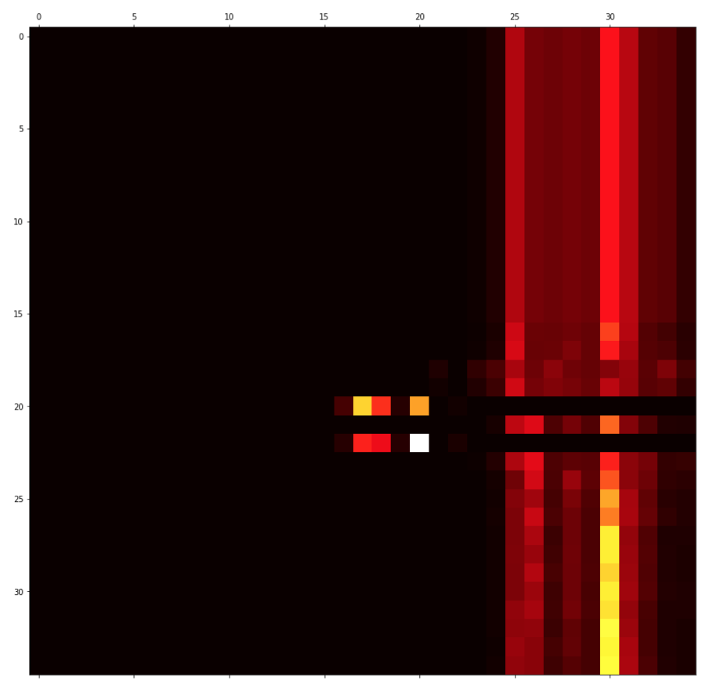
III. Product Profile Extraction by NER —Which ML Model Works Best?
Recurrent Neural Network, CRF, Attention
Amazon Confidential

Slide 52
III. Extracting Knowledge from Product Profiles in Amazon Catalog
Review extraction & sentiment analysis
Open aspect extraction
Automatically building a shallow KG
Product profile extraction
Notes:
Galaxy

Slide 53
IV. Graph Mining and Embedding
Querying
Graph
Mining
Embedding
Generation
Recommen-dation
Search, QA, Conversation
Graph
Applications
Product Graph
Graph
Construction
Schema
Mapping
Entity
Resolution
Knowledge
Cleaning
Knowledge
Cleaning
Ontology
Ingestion
Web
Extraction
Catalog
Extraction
Knowledge
Collection

Slide 54
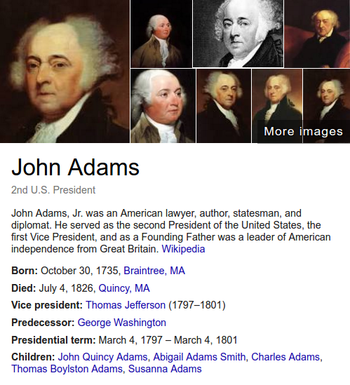
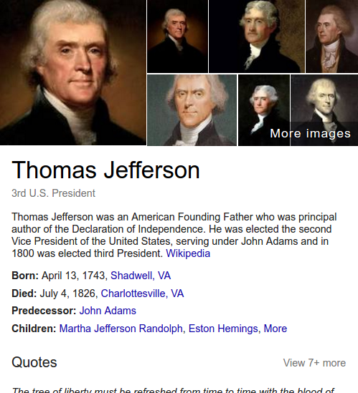
IV. Graph Mining and Embedding
Notes:
Add graph

Slide 55
IV. Graph Mining
Finding importance of entities and relationships
Similar but different products
Explain why “People who bought A also bought B”
Trend discovery
Customer product graph
Embeddings for entities, products, and customers

Slide 56
IV. Graph Embedding for Entity Resolution
Notes:
Add graph

Slide 57
Weighted Sum of two max-margin objectives
$$($$
Generic Loss L1
Resolution Loss L2
$$)$$
Basic Blocks of Deep Knowledge Embedding Model
Triplet
Score
$$($$
Relational Score Function $g(∙)$
$$)$$
Hidden
Layer
$$($$
$$)$$
Embed
Function
$$)$$
$$($$
$$f_{a}(∙)$$
$$f_{v}(∙)$$
$$f_{r}(∙)$$
$$f_{t}(∙)$$
$$f_{e}(∙)$$
$$a_{1} v_{1}$$
$$a_{2} v_{2}$$
$$a_{n} v_{n}$$
$$…$$
(Entity e)
(Neighborhood N(e))
(Attributes A(e))
(Relationship r)
(Types T(r))

Slide 58
IV. Graph Embedding for Entity Resolution
 | Link prediction |  | Entity resolution
 | IMDB-MRR | FB-MRR | AUPRC
RASCAL | 0.574 | 0.147 | 0.32
TransR | 0.621 | 0.132 | 0.29
HolE | 0.712 | 0.224 | 0.42
GAKE | 0.421 | 0.112 | 0.45
Ours | 0.763 | 0.310 | 0.58
Notes:
Add graph

Slide 59
Take Aways
We aim at building an authoritative knowledge graph for all products in the world
We shoot for roofshot and moonshot goals to realize our mission
There are many exciting research problems that we are tackling

Slide 60
Thank You!

